Slide 1

AKS Production Patterns Workshop
Kevin Harris ( @kevbhar): Kevin.Harris@Microsoft.com
Dave Strebel ( @dave_strebel): Dave.Strebel@Microsoft.com

Slide 2
Agenda
Day 1
Morning
Intros & Expectations
Cluster Management: GitOps, Patching, Upgrading, Cost Governance
Cluster Management Hands-on Exercise
Afternoon
Future of Cluster Management
Observability: Logging, Metrics, Dashboards
Observability Hands-on Exercise

Slide 3
Agenda Cont.
Day 2
Morning
Security: Kubernetes Policy, Secrets Mgmt, Build & Runtime Image Mgmt
Security Hands-on Exercise
Afternoon
Future of Security: ASC + AKS Policy + ACR
Service Mesh: Linkerd, Istio, Consul
Service Mesh Hands-on Exercise
Future of Service Mesh

Slide 4
Introductions & Expectations

Slide 5
Introductions
Who are you?
What do you do?
What do you want to get out of this workshop?
What are you currently struggling with around AKS?

Slide 6
Setting Expectations
NOT an Introduction to Containers, Kubernetes & AKS
Targeted at Highly Regulated Customers (ie. Financial Services, Insurance)
Familiarity with Azure & Completed AKS Workshop or have some experience with AKS (ie. Not the first time using Kubernetes)
Have a target Application Workload that needs to move into Azure + AKS
Will be Hands-on & Discussion
Provide Feedback
Content is “Not Comprehensive”, but a representative sample
Content is “Opinionated”, but not meant to be “Set in Stone”

Slide 7
Targeted Audience
Security/Risk Lead
Compliance Lead
InfoSec Lead
Identity & Access Mgmt Lead
Networking Lead
Cloud Engineering Lead
Line of Business Owner

Slide 8
Why?
Kubernetes is a Hot Topic
Top of mind for many Enterprise Organizations
Something repeatable for Customers and the Field
A place to Start
Lots of Questions???

Slide 9
Goals
Production Patterns for AKS in Azure
How to manage AKS clusters at scale?
What to observe for within AKS clusters?
What security controls should be put in place?
Do I need a Service Mesh?

Slide 10
AKS Setup Before

Slide 11
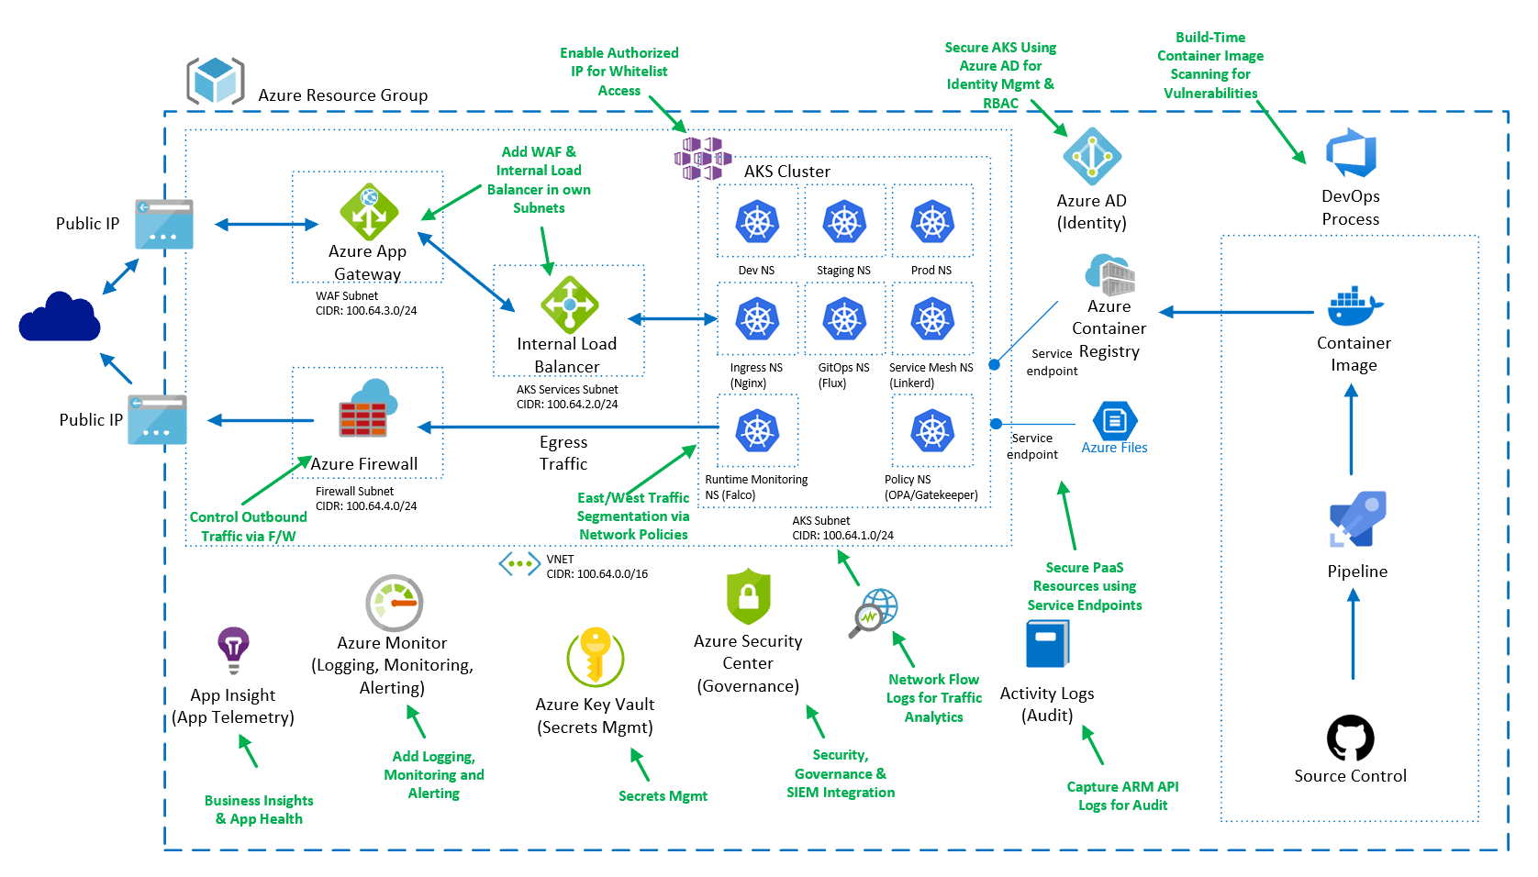
AKS Setup After

Slide 12
Cluster Management

Slide 13
Cluster Management
What is it?
Guidance is more smaller clusters, but how do we manage that?
Do I still need to patch?
How should I be handling upgrades?
What about managing costs?

Slide 14
What is up with all these Service Principals?
Cluster Service Principal
To allow an AKS cluster to interact with other Azure resources, an Azure Active Directory service principal is used.
AD Integration Objects
When configuring Azure AD for AKS authentication, 2 Azure AD application are configured.
Server Application - used to get a users Azure AD group membership
Client Application - used when logging in with the Kubernetes CLI (kubectl
You can Rotate/Update them with:
$ az aks update-credentials --resource-group myResourceGroup --name myAKSCluster --reset-service-principal --service-principal $SP_ID --client-secret $SP_SECRET

Slide 15
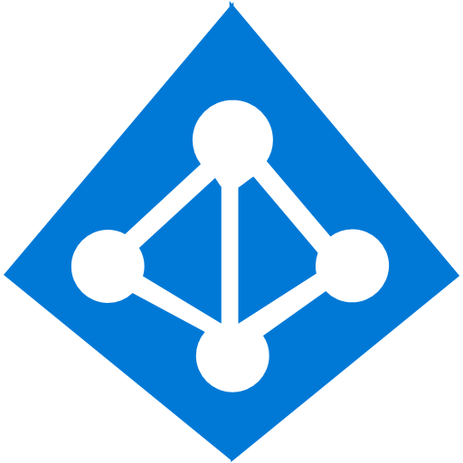
Cluster Level – Kubernetes RBAC and Azure AD integration
Kubernetes Developer authenticates with AAD
The AAD token issuance endpoint issues the access token
Azure Active Directory
Developer performs action w/ AAD token. Eg. kubectl create pod
1
4
<\>
Token
2
Kubernetes validates token with AAD and fetches the Developer’s AAD Groups Eg. Dev Team A, App Group B
Developer
3
AKS
5
Kubernetes RBAC and cluster policies are applied
6
Request is successful or not based on the previous validation

Slide 16

Azure Level - Kubernetes RBAC and Azure RBAC Roles
Kubernetes Administrator
Kubernetes Administrator authenticates with AAD
1
The AAD token issuance endpoint issues the access token
Azure Active Directory
Token
2
Administrator fetches the admin kubeconfig and configures RBAC roles and bindings
3
<\>
Token
Kubernetes Developer fetches the user kubeconfig
Developer
AKS
4

Slide 17
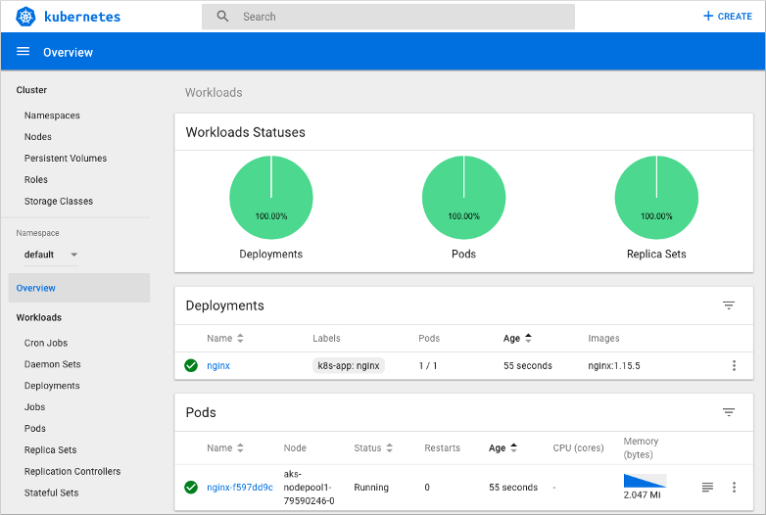
Kubernetes Dashboard

Slide 18
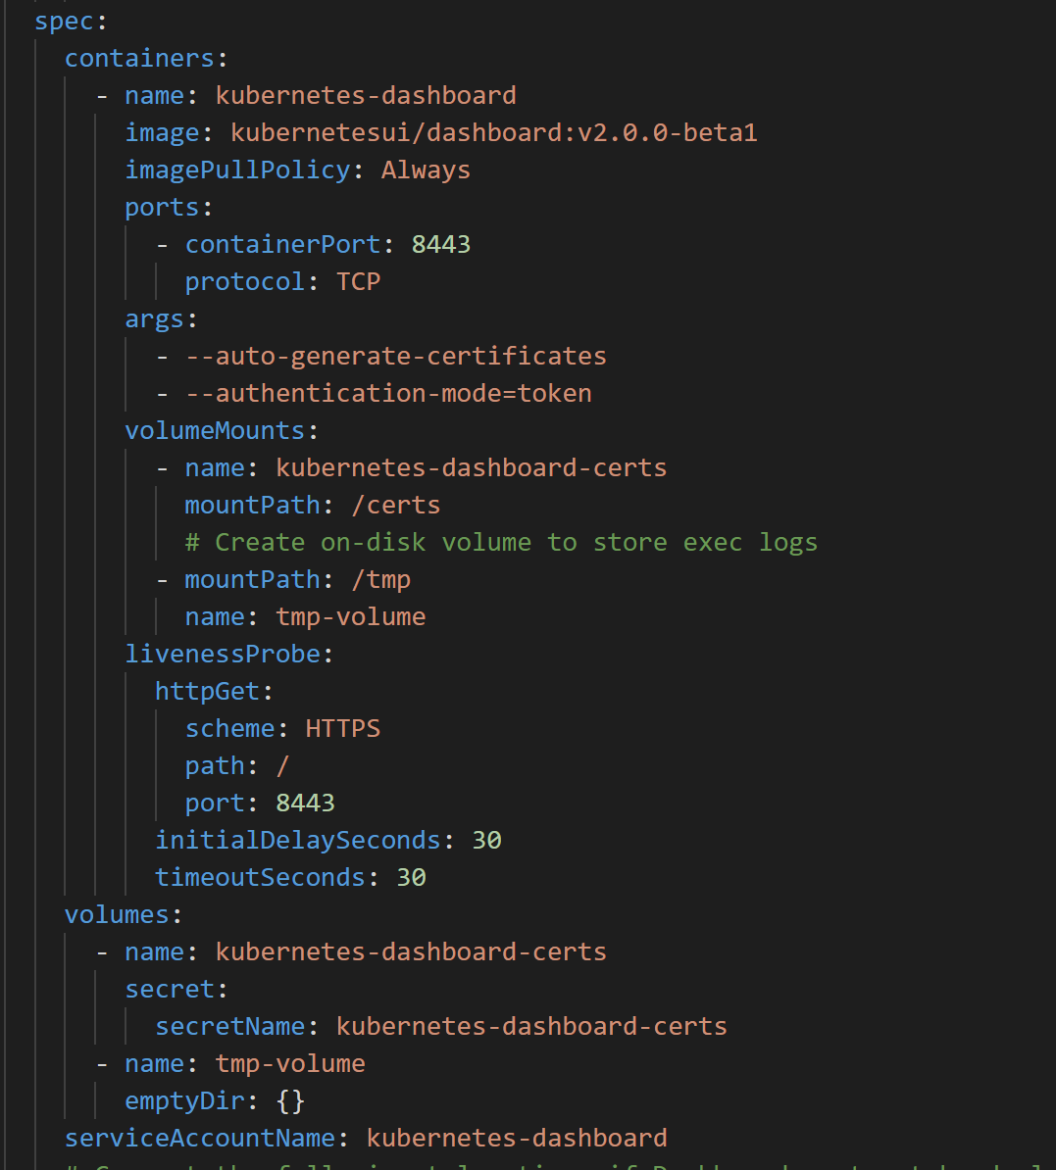
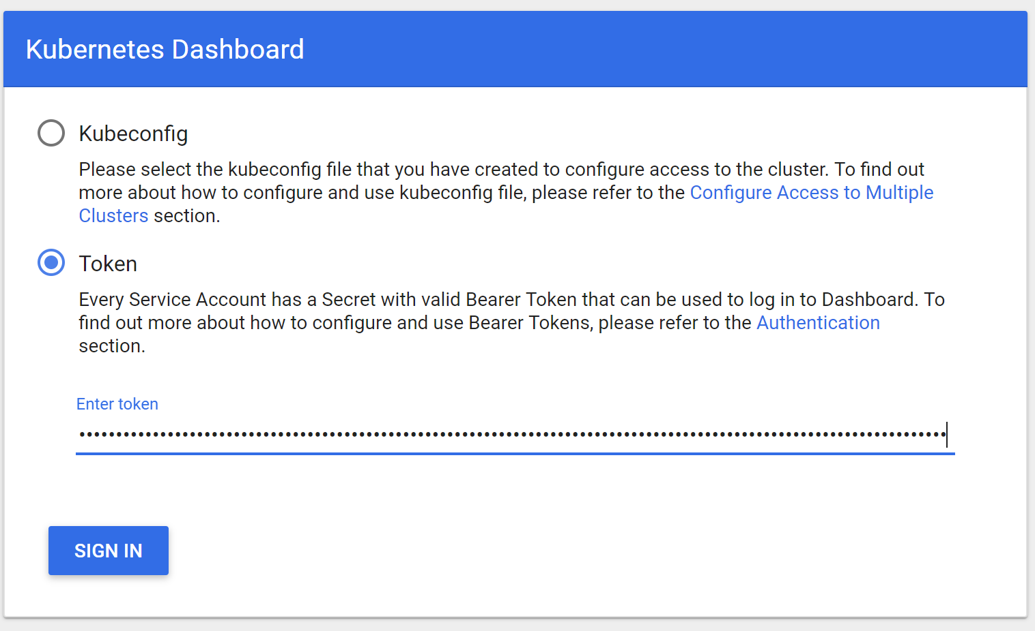
Kubernetes Dashboard – less worse

Slide 19
GitOps – Definition
Git as the source of truth for a system
Git as the single place where we operate (create, change, and delete)
All changes are observable
https://www.weave.works/technologies/gitops/

Slide 20
GitOps – Principles
System state described declaratively
State declaration versioned in source control
Approved changes are applied automatically
Agents enforce desired state
https://www.weave.works/technologies/gitops/

Slide 21
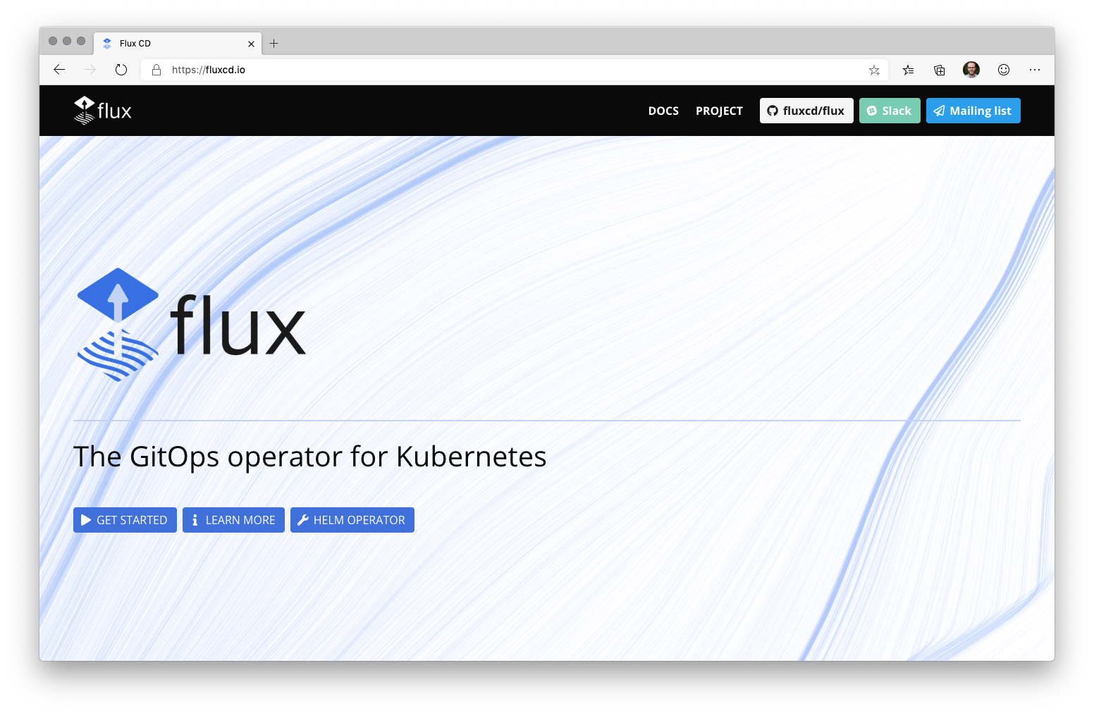
Notes:
GitOps coined by Weave Works
Flux is an in-cluster operator which implements the GitOps pattern
Flux is now a CNCF (Cloud Native Compute Foundation) Sandbox project

Slide 22
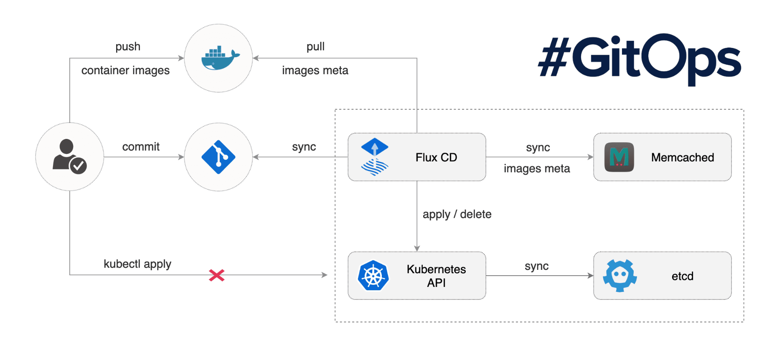
GitOps Approach
https://github.com/fluxcd/flux
Notes:
For runtime enforcement, consider a process that deploys only those images that pass vulnerability scanning and those that adhere to the organization’s hardening policies. Kubernetes provides mechanisms to exercise such enforcement policies.
For remediation, ensure that the vulnerability scanning and security assessment function is integrated with the organization’s continuous integration/continuous deployment (CI/CD) pipeline. This way, the scanning results are fed directly to the pipeline, thereby kicking off remediation workflows before deployment. This should, in turn, be integrated with Kubernetes’ rolling updates feature, ensuring vulnerable containers are taken offline and replaced with freshly built images without the known flaws.

Slide 23
GitOps – Multi-tenancy
https://github.com/fluxcd/multi-tenancy

Slide 24
GitOps – Helm chart support
https://github.com/fluxcd/helm-operator-get-started

Slide 25
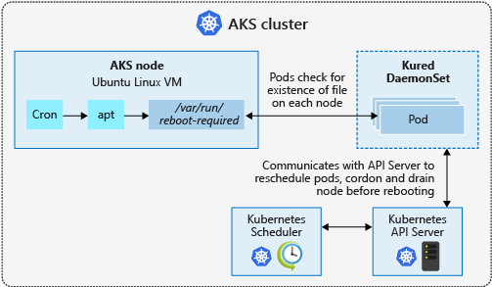
Process Node OS Security Patches
AKS automatically applies security patches to the nodes on a nightly schedule
You’re responsible to reboot as required
Regular maintenance recommended
Monthly ideal, 3 months maximum
Use Kured DaemonSet to watch for nodes requiring a reboot and handle the reschedule of the pods and reboot of the nodes. Check AKS documentation for guidance to use Kured

Slide 26
Cluster Level – Nodes, Upgrade and Patches
Regular maintenance, security and cleanup tasks
Maintain, update and upgrade hosts and kubernetes - Monthly ideal, 3 months minimum
Security patches
AKS automatically applies security patches to the nodes on a nightly schedule
You’re responsible to reboot as required, leveraging tools like Kured DaemonSet https://github.com/weaveworks/kured
Upgrade to new versions
$ az aks upgrade --name myAKSCluster \ --resource-group myResourceGroup \ --kubernetes-version 1.10.6
SSH Access
DenyEscalatingExec
Running benchmarks and tests to validate cluster setup
Kube-bench
Aqua Hunter
Others

Slide 27
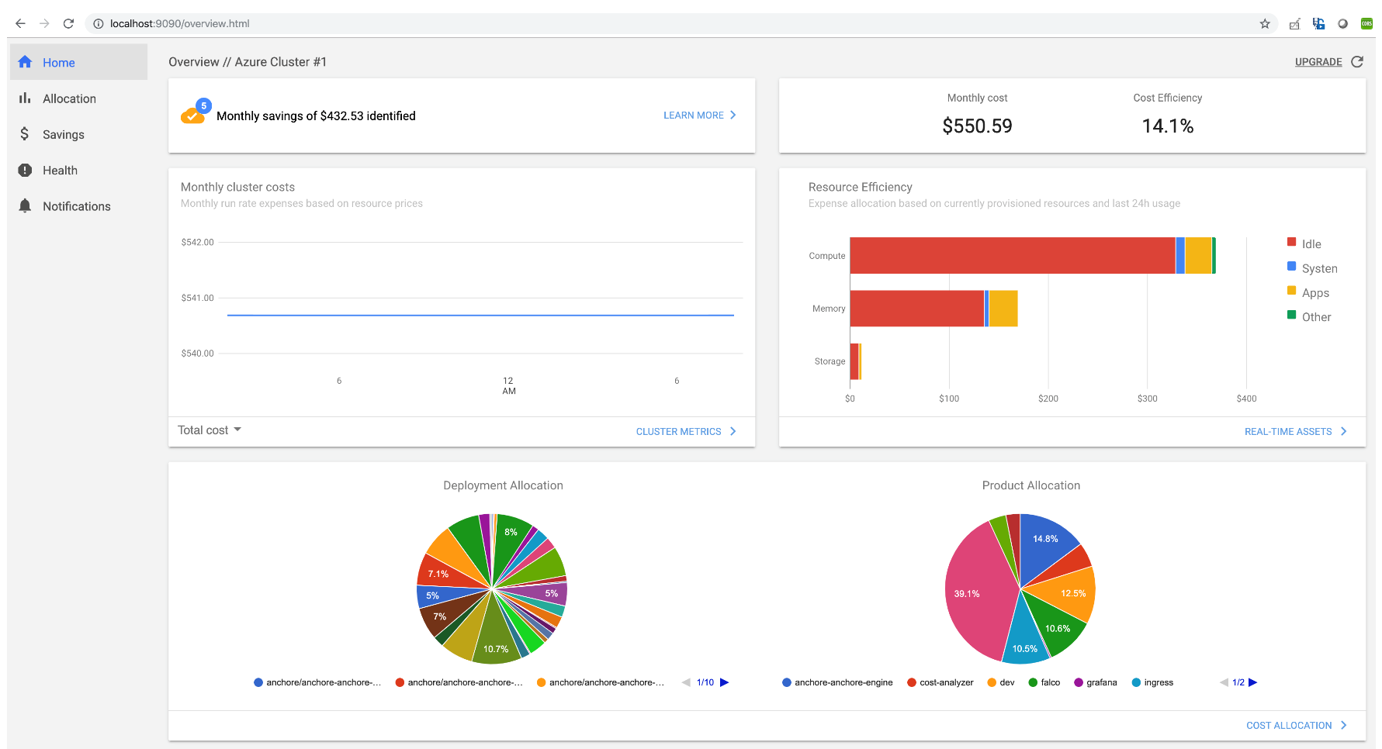
Cost Governance – Kubecost

Slide 28
To-Do
Cluster Management Hands-on Exercise

Slide 29
Discussion
What worked? What didn't work?
Were steps/guidance missing? (ie. Is the content good enough or too much?)
Was there something in there you were expecting to see, but didn’t?
What was automatically created? And what were their purposes?
Where can you see if there is any configuration drift?

Slide 30
Azure Arc
Bring Azure services and management to any infrastructure
Run Azure data services anywhere
Extend Azure management across your environments
Adopt cloud practices on-premises
Implement Azure security anywhere
Azure Arc is a set of technologies that extends Azure management and enables Azure services to run across on-premises, multi-cloud, and edge.

Slide 31


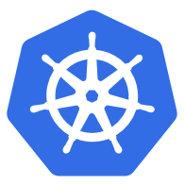

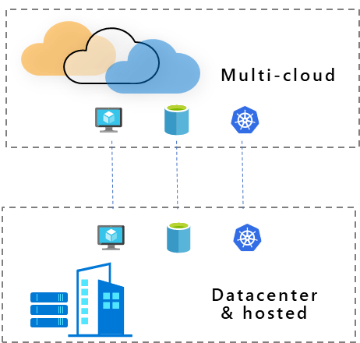

Azure Arc
Customer use cases
Multi-cloud
Datacenter & hosted
Organize and govern across environments
At-scale Kubernetes app management
Run data services anywhere
Get Kubernetes clusters and servers that are sprawling across clouds, datacenters and edge under control by centrally organizing and governing from a single place.
Deploy and manage Kubernetes applications at scale across environments using DevOps techniques. Ensure that applications are deployed and configured consistently from source control, at scale.
Deploy and manage data services where you need it for latency or compliance reasons. Always use the most current technology and seamlessly manage and secure your data assets across on-premises, clouds and edge.

Slide 32





Azure Arc for Kubernetes – Customer Journey
Create
Connect
Configure
App delivery/ Management
Operations
Open Source Ecosystem – DIY
Partners to integrate support directly
Microsoft first-party Kubernetes offerings
AKS/Azure Stack Hub & Edge/AKS Engine
Deploy Arc agents to existing K8s cluster
Azure Arc enabled clusters gain secure access to the Azure Resource Manager ecosystem
Manage, apply, monitor, and enforce Kubernetes configuration across one or more clusters from the Azure Portal and GitOps workflows
Deploy custom in-house applications, ecosystem/partner solutions, and Microsoft services
Azure Resource Manager capabilities for ongoing operations
Any infrastructure
Use familiar tools and skillsets

Slide 33
Azure Arc for Kubernetes is…
Single pane of glass across your entire cluster inventory
At-scale, GitOps, multi-cluster configuration and workload management
Azure management capabilities brought to all clusters for consistency
Separation of concerns for IT and app dev
Cluster provisioning
Cluster lifecycle management
Cluster upgrade and patch management
Azure Arc for Kubernetes is not (yet)…

Slide 34
Key takeaways for Azure Arc for Kubernetes
Central management
Cluster organization and inventory with a unified view in the Azure Portal across all locations
At-scale control
At-scale configuration and workload management
GitOps
GitOps model for configuration and app deployment from single sources of truth to one or many clusters
Integrates with your dev tooling and CI pipeline
Azure management
Azure management capabilities brought to all clusters for consistent management

Slide 35
Azure Arc for Kubernetes
Onboarding

Slide 36
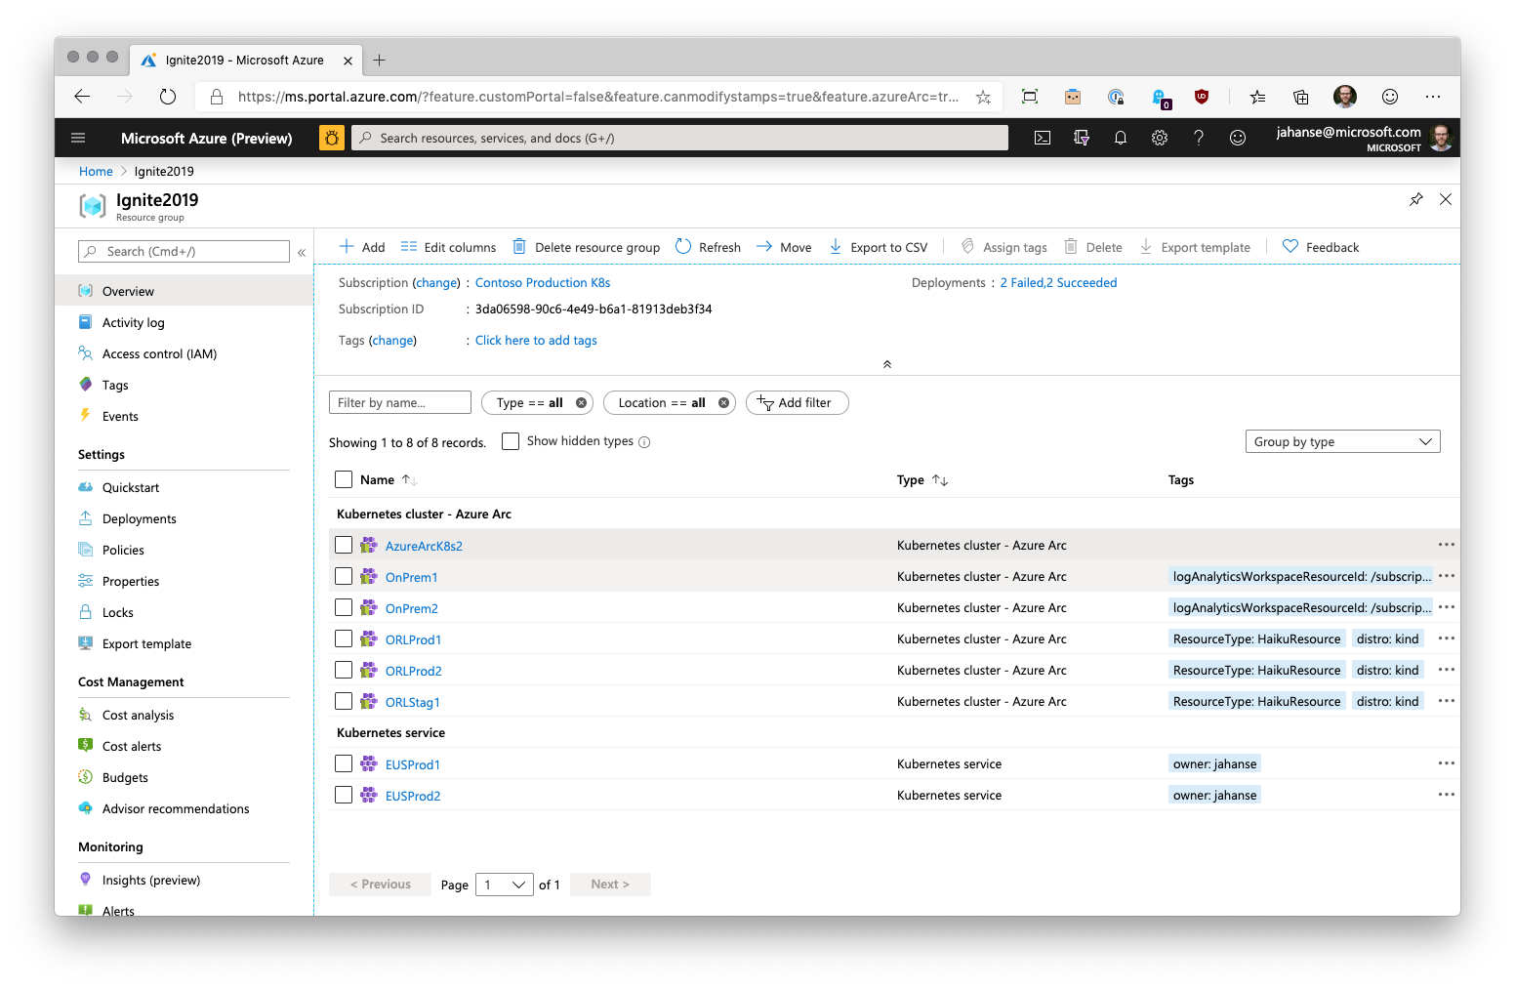

Slide 37
Azure Arc for Kubernetes
Configuration

Slide 38
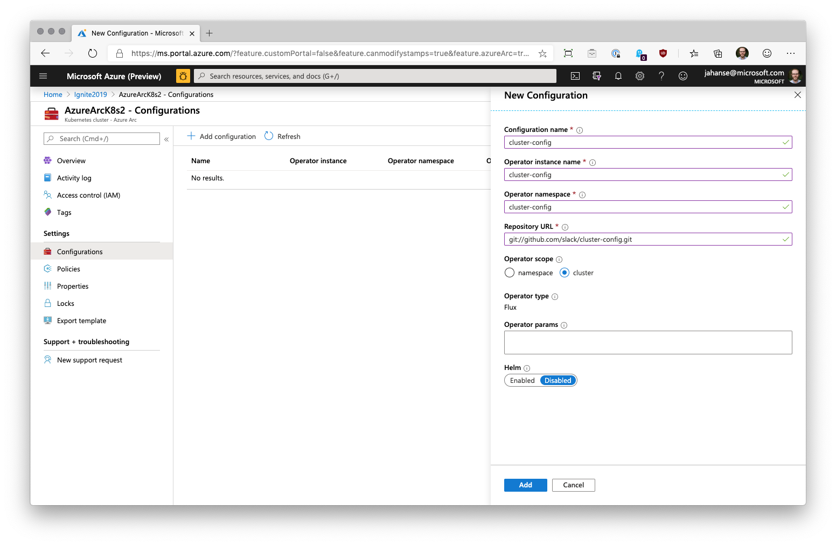

Slide 39
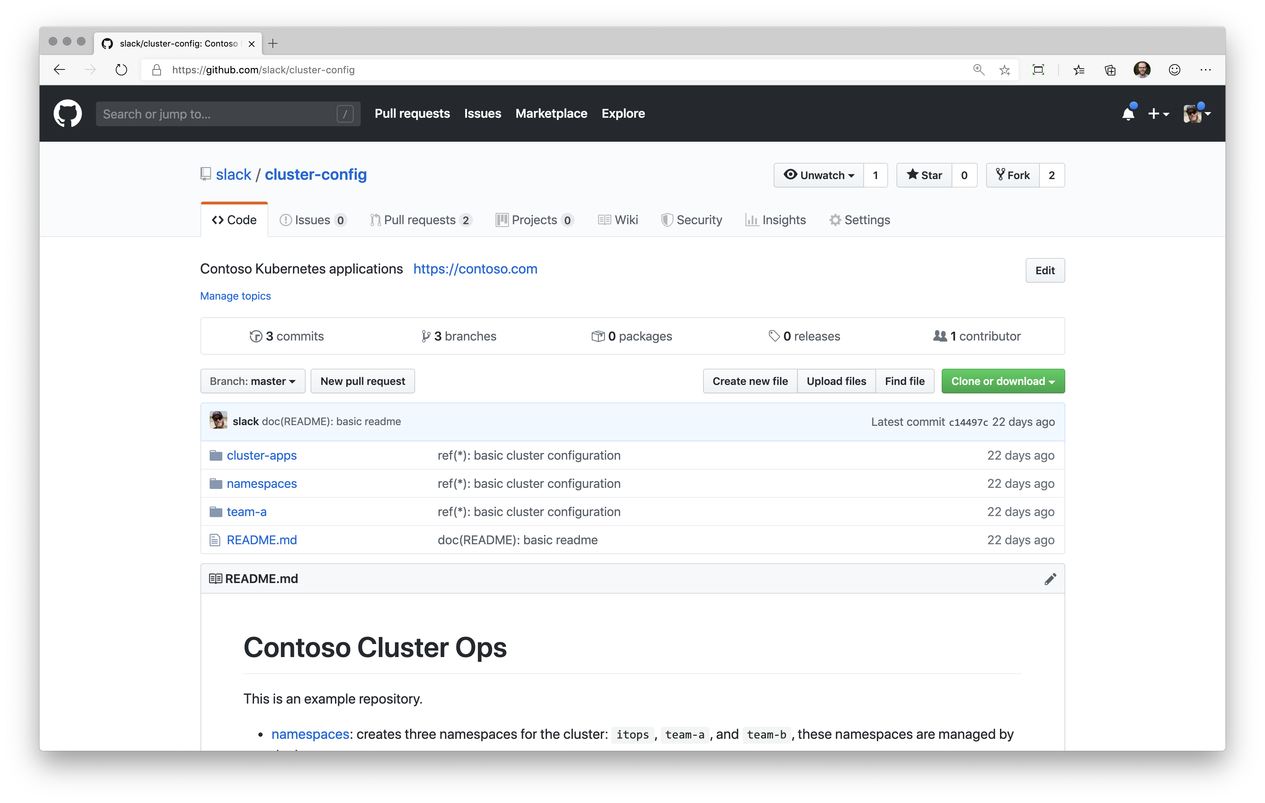

Slide 40
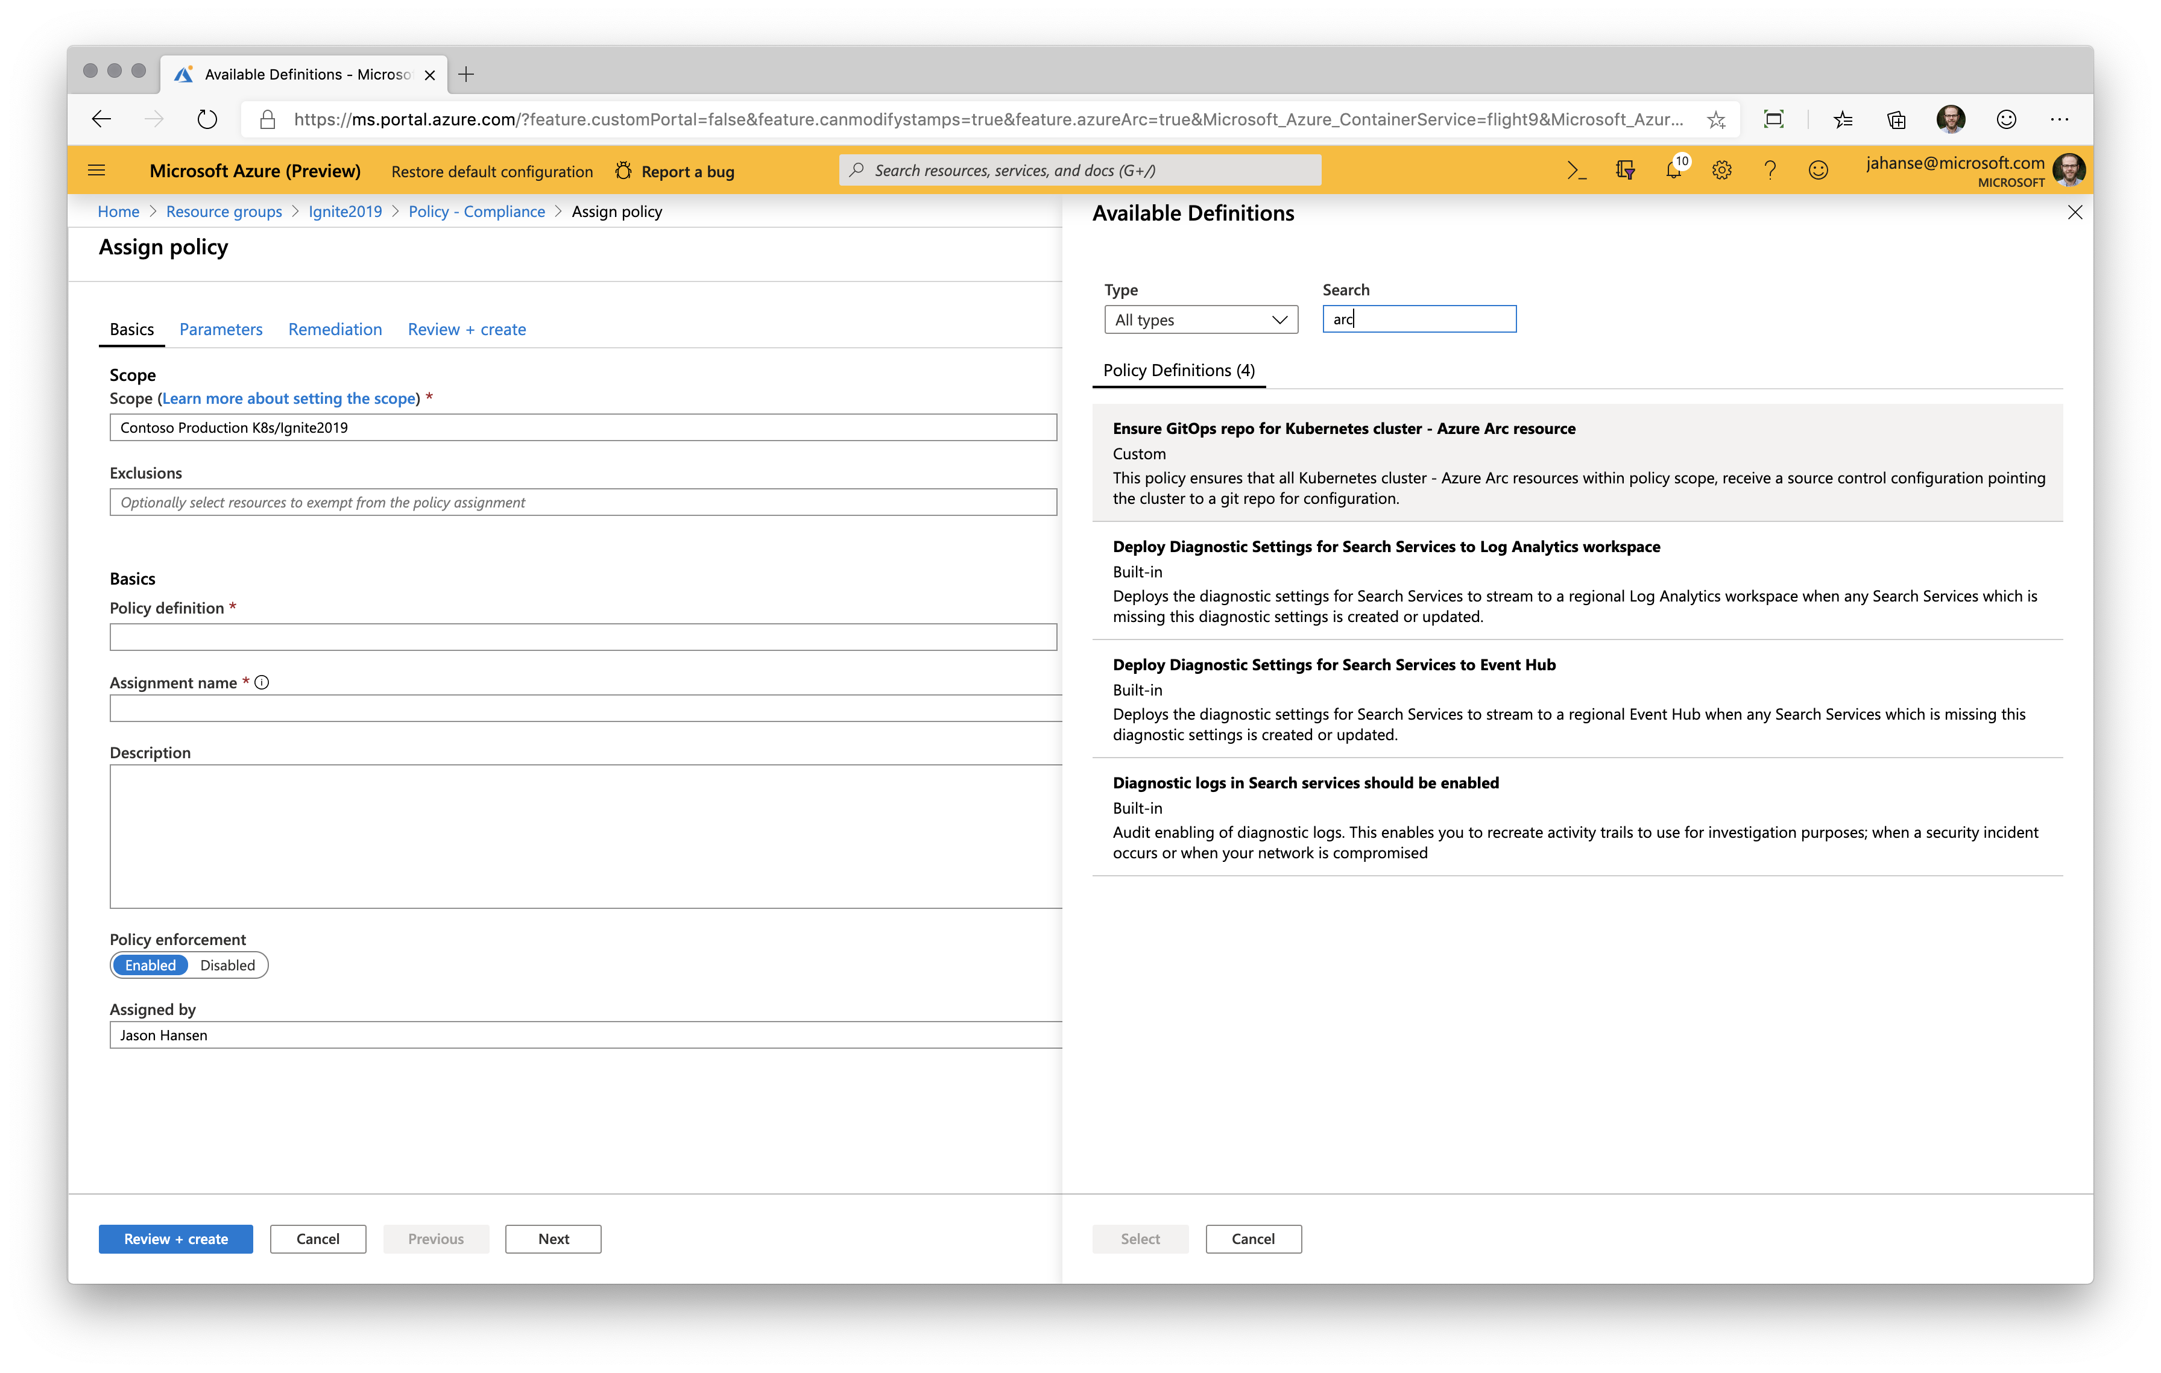

Slide 41
Azure Arc for Kubernetes
Azure Policy

Slide 42
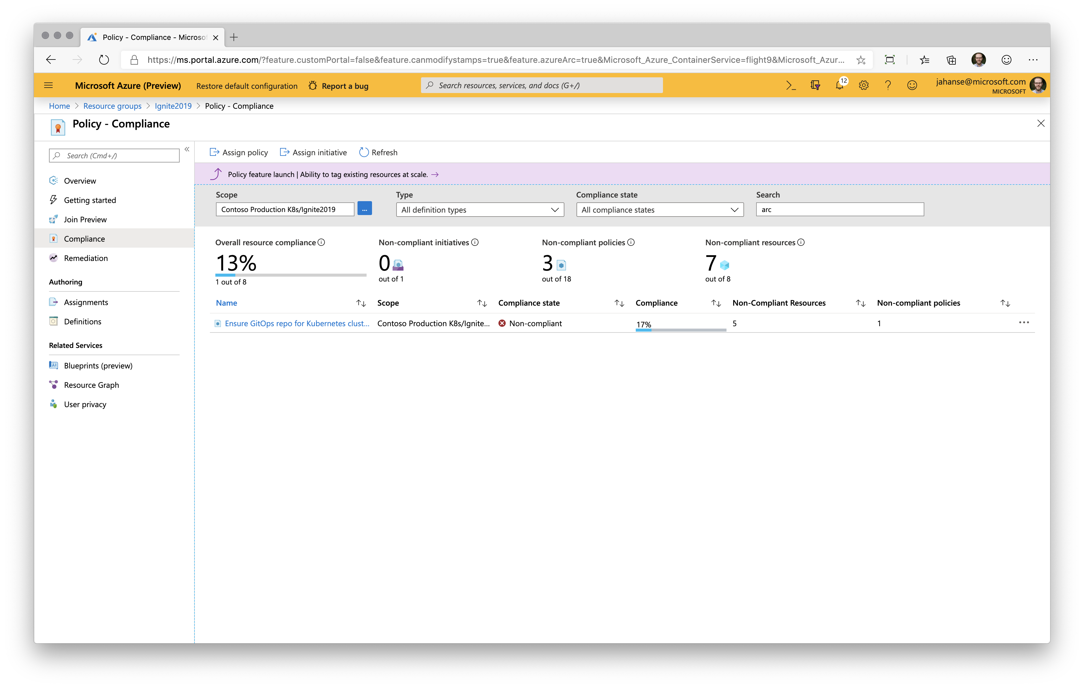

Slide 43
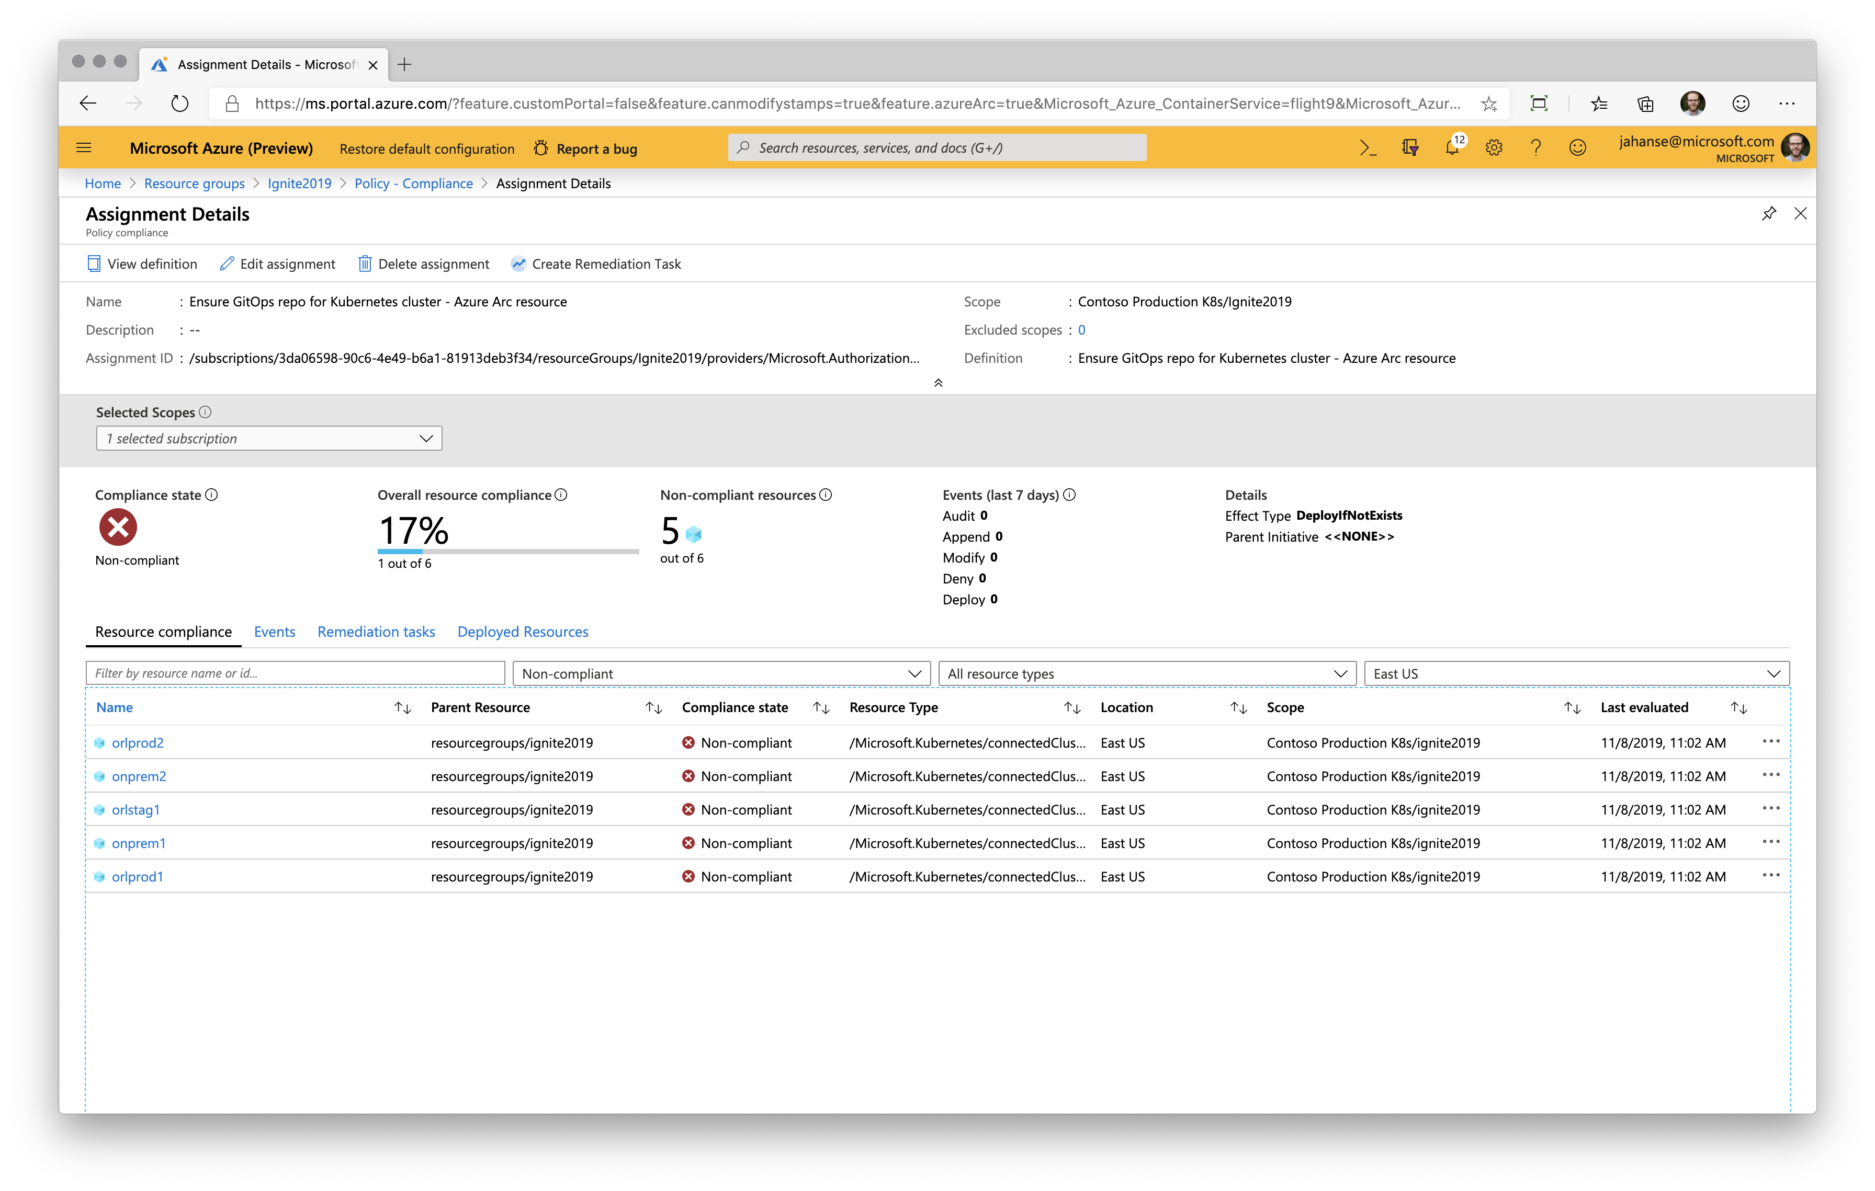

Slide 44
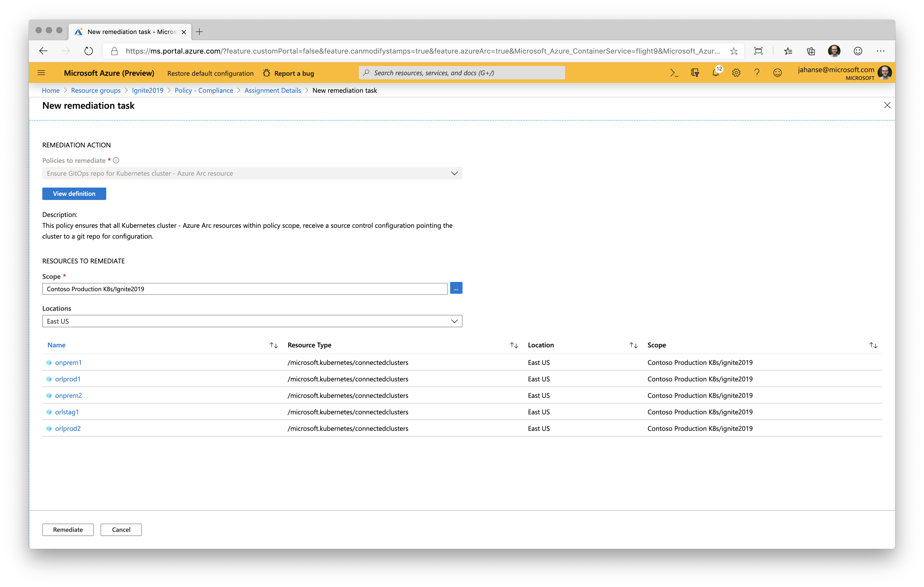

Slide 45
Azure Arc for Kubernetes
Monitoring

Slide 46
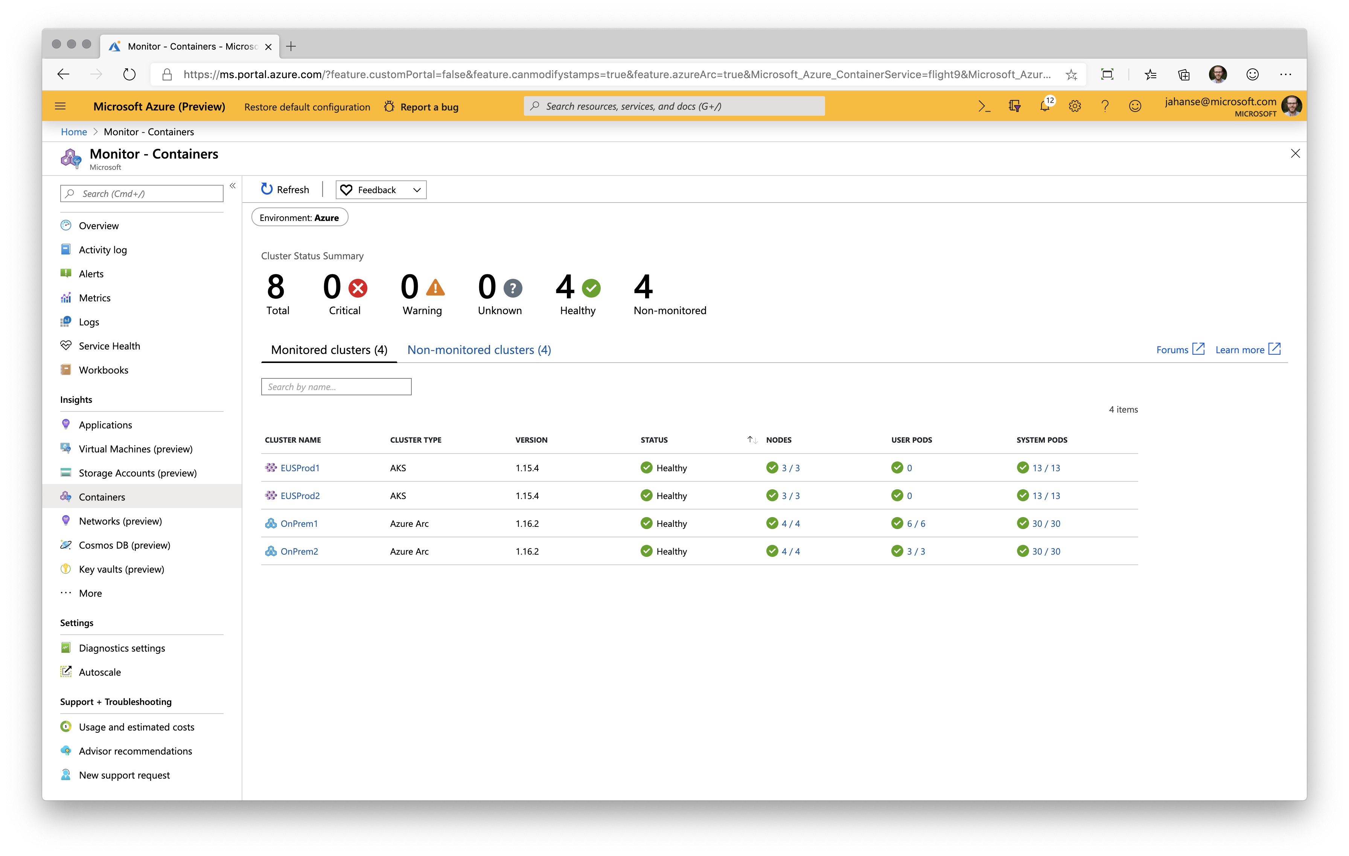

Slide 47
Azure Arc for Kubernetes
Architecture

Slide 48
Azure Arc for Kubernetes
Azure
Customer locations
Management experiences
Azure Resource Manager
Kubernetes
Azure Portal
Identity
Kubernetes
Azure CLI
RBAC
Azure SDK
Kubernetes
Container registry
Policy
GitOps Manager
Index
Azure Arc K8s RP
Azure Arc K8s agent
K8s API
K8s Native Tools
Cluster provisioning​
Cluster upgrade and patch management​
Cluster lifecycle management​
Cluster monitoring
Groups
Kubernetes
Etc.
Kubernetes
Azure Arc:

Slide 49
Azure Arc for Kubernetes – Scenario summary
Cluster inventory: connect any Kubernetes cluster to Azure for inventory, organization, and tagging
Basic configuration management: manage configuration for one cluster
Multi-cluster configuration management: manage configuration for clusters in multiple locations (sites, clouds, etc.)
Separation of concerns: manage cluster configuration and application configuration with multiple repositories
At-scale governance and compliance: enforce any CM scenario using Azure Policy

Slide 50
Observability

Slide 51
Observability
What is it?
Separate Logging from Metrics
How is the data going to be viewed?
Large Topic, Focus is on Logging, Metrics & Dashboard Visualization

Slide 52
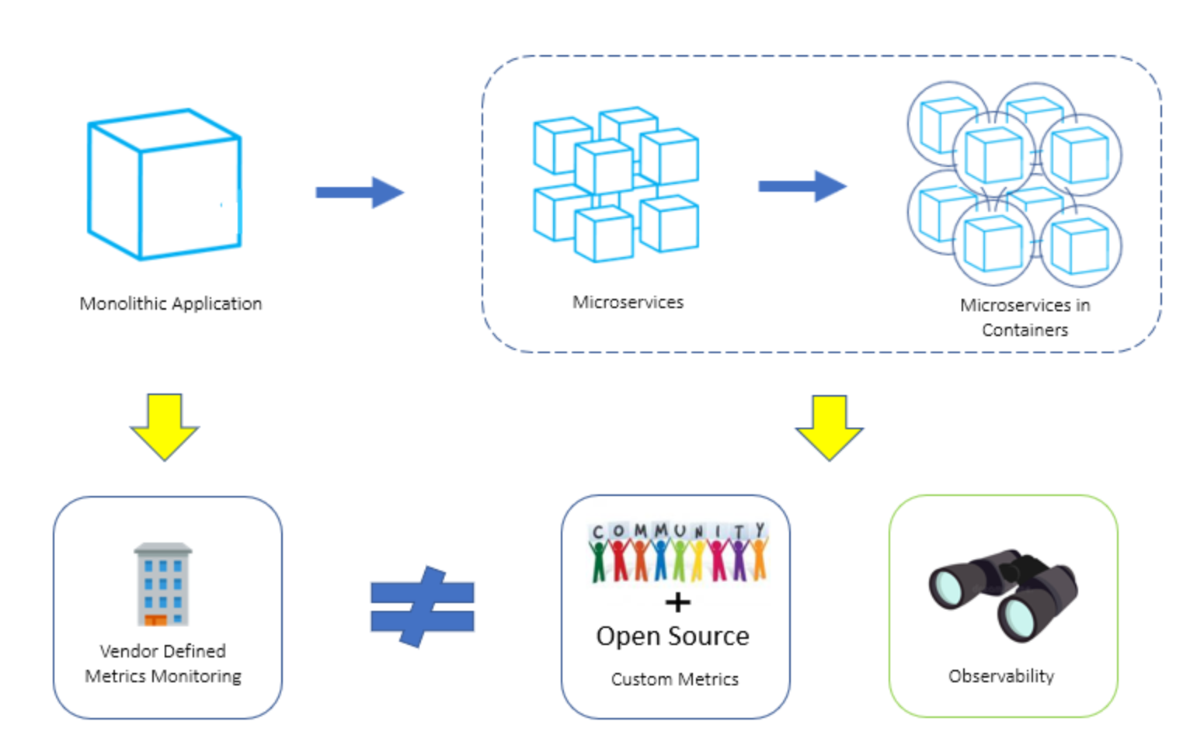
Observability
It’s more than just the App
It’s the Full Stack (Nodes to K8s Infra to App Workload)
Works with Live Data
Notifications & Alerts

Slide 53
Logs vs Metrics
Logs:
Data about a specific event, typically string-based in nature
E.g. Container Logs
Metrics:
Measurement at a point in time (time-series metrics)
Health of the System
E.g. CPU Utilization

Slide 54
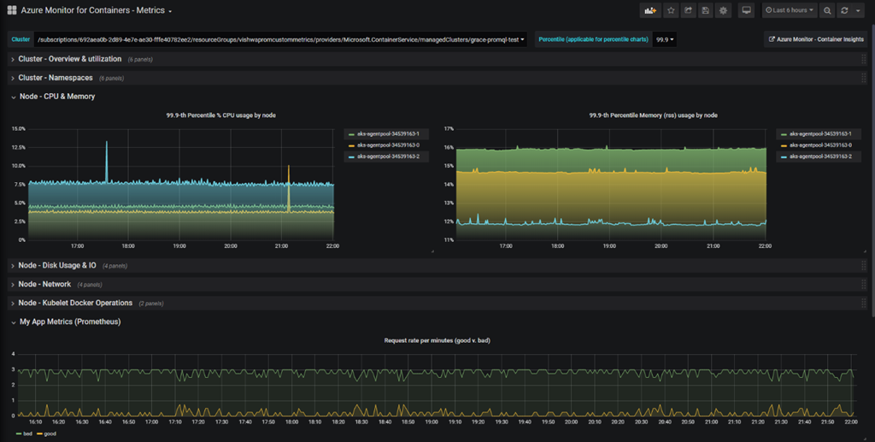
Dashboards
Visualizing Metrics

Slide 55








Azure Monitor for Containers - Logging
Cloud Native experience to Azure Monitor with Prometheus integration.
Observe live container logs and Kubernetes event log on container deployment status
Visualize overall health and performance from cluster to containers with drill downs and filters.
Insightful Monitoring
and Alerting
Visualization
1
Observability
2
Provide insights with multi-cluster health roll up view.
Insights
Azure Pipeline
Azure Kubernetes Service
Azure Monitor
for Containers
Monitor and analyze Kubernetes and container deployment performance, events, health, and logs
Monitor
Analyze
AKS Virtual Node
Native alerting with integration to issue managements and ITSM tools.
Response

Slide 56
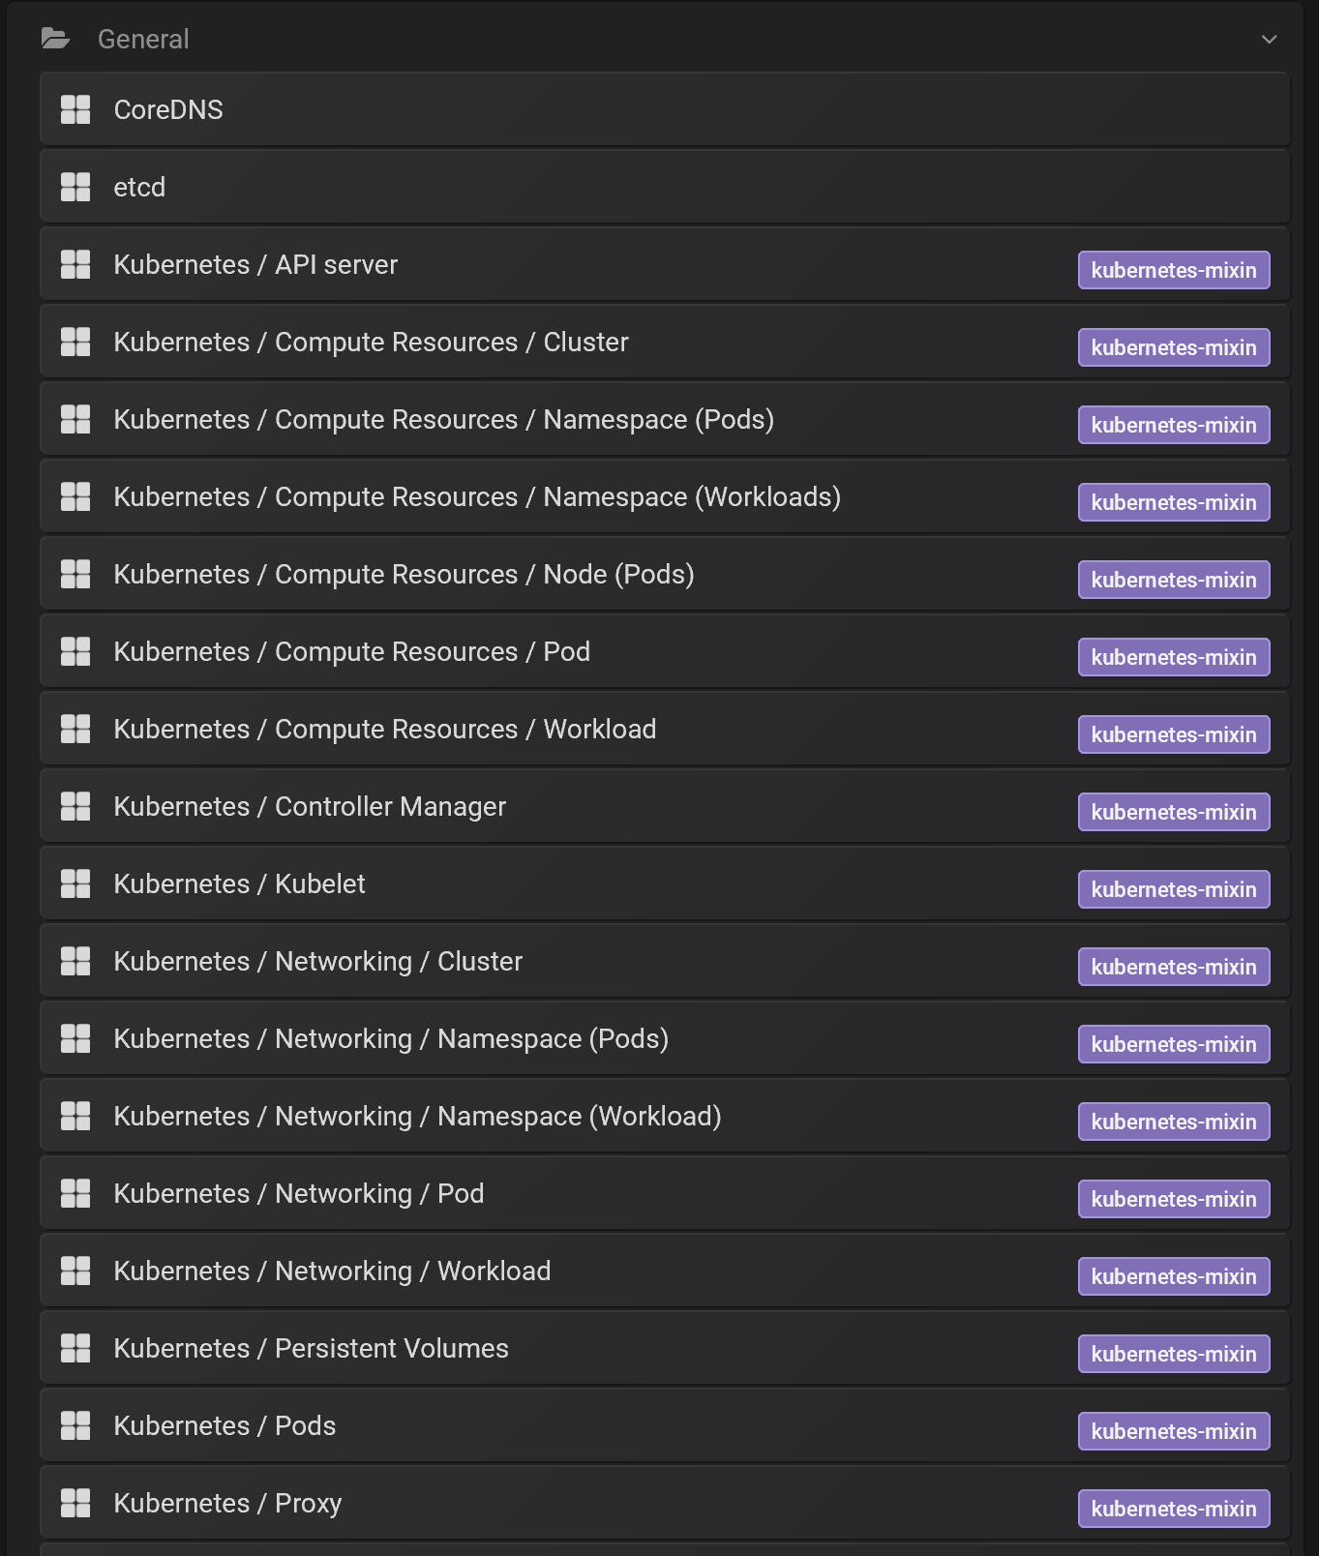
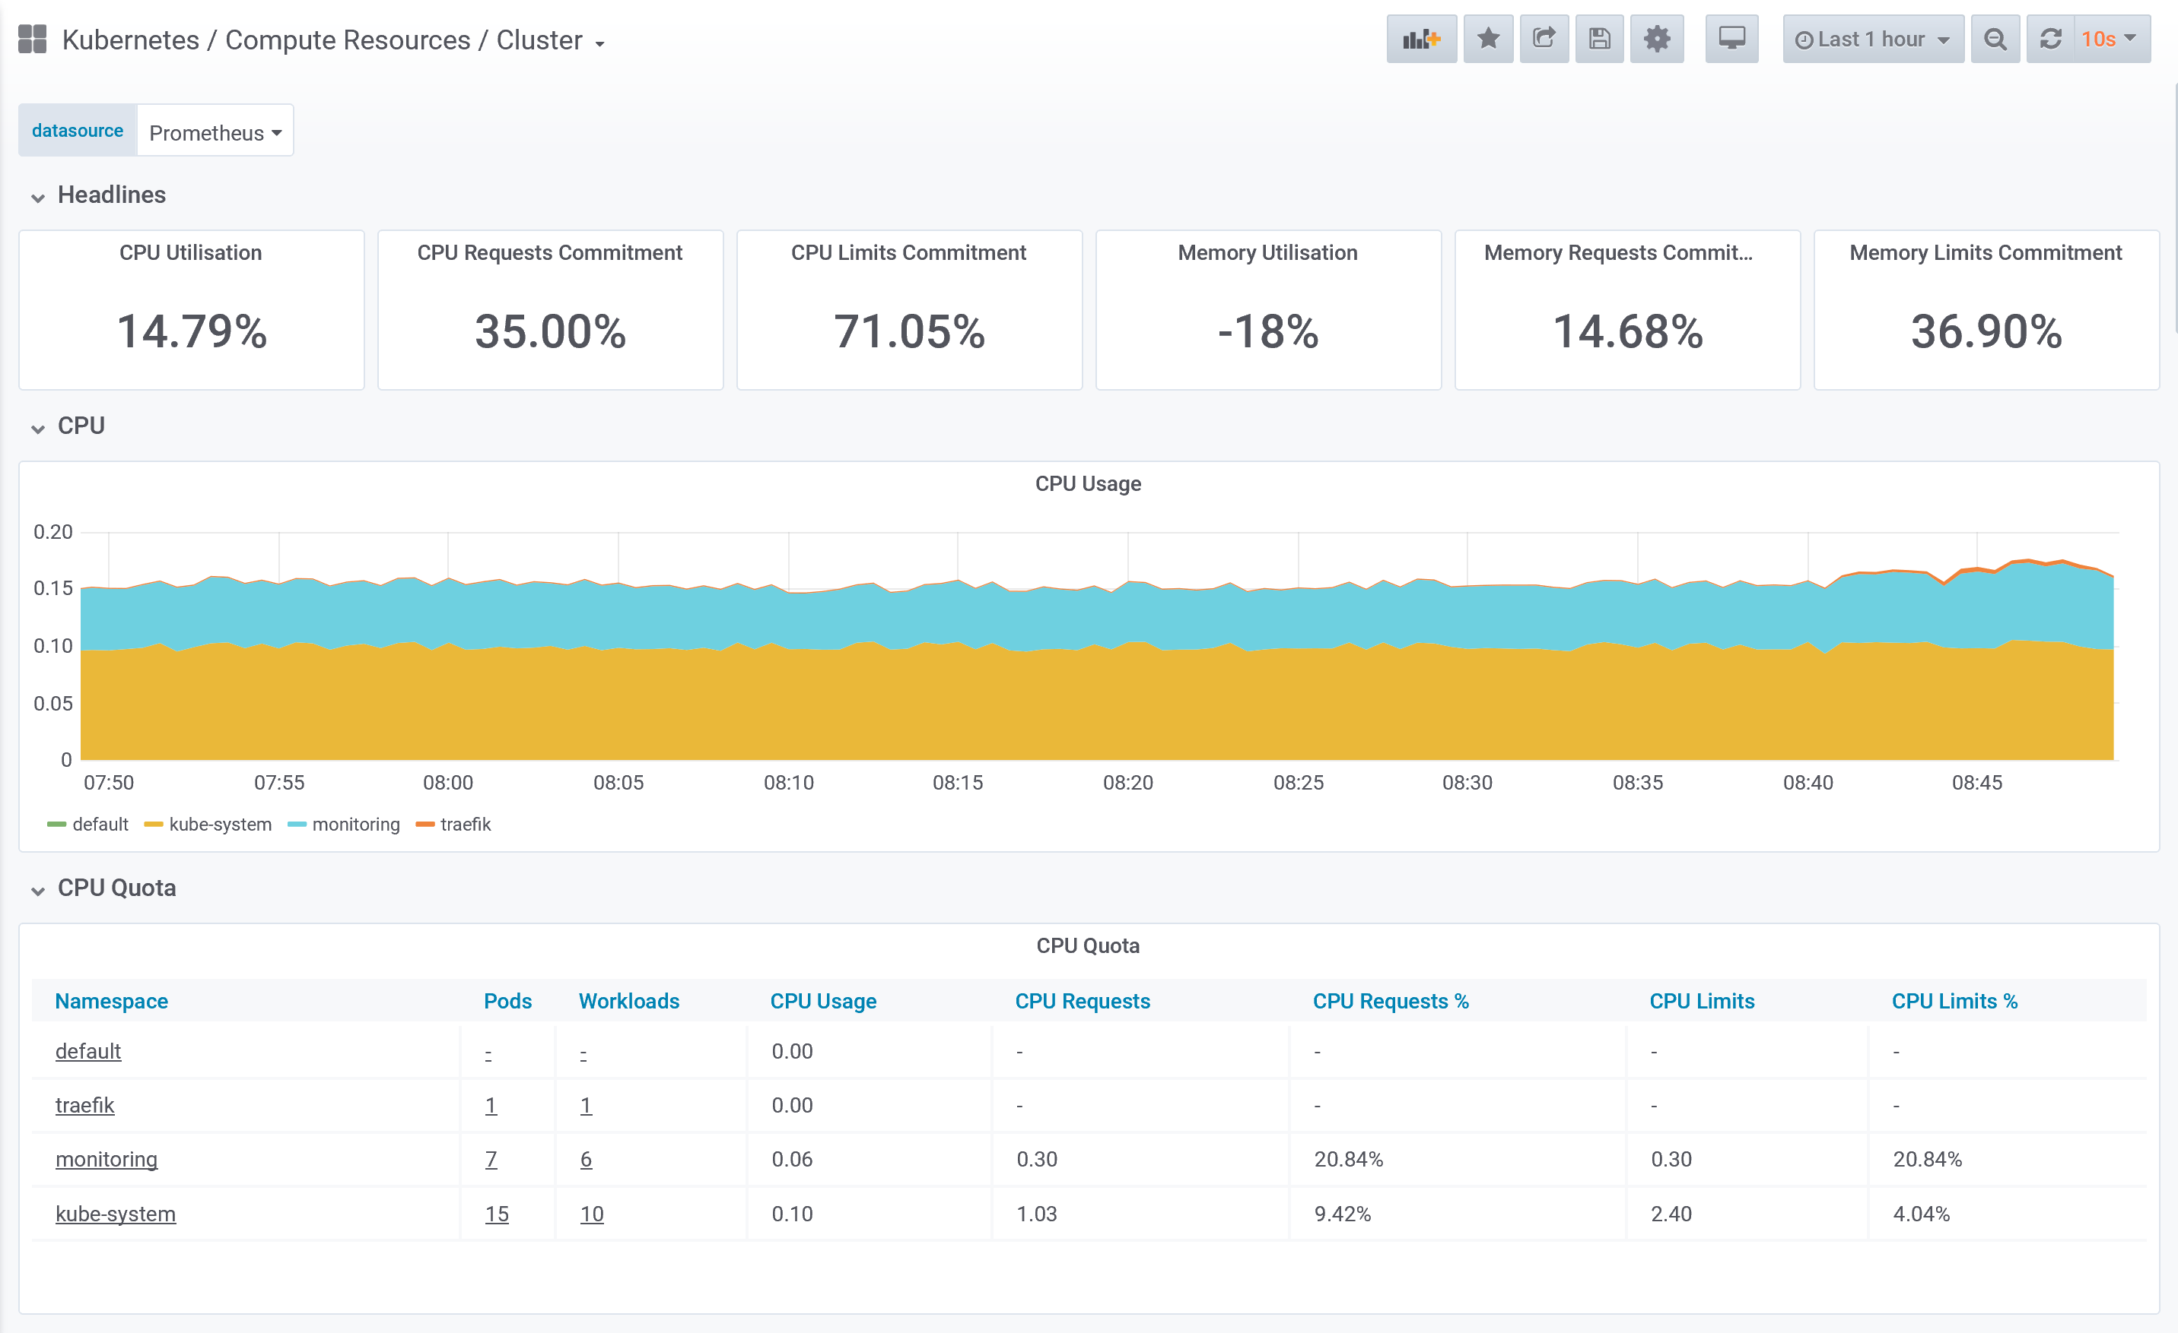
Prometheus & Grafana – Metrics
Out of the box Dashboards

Slide 57
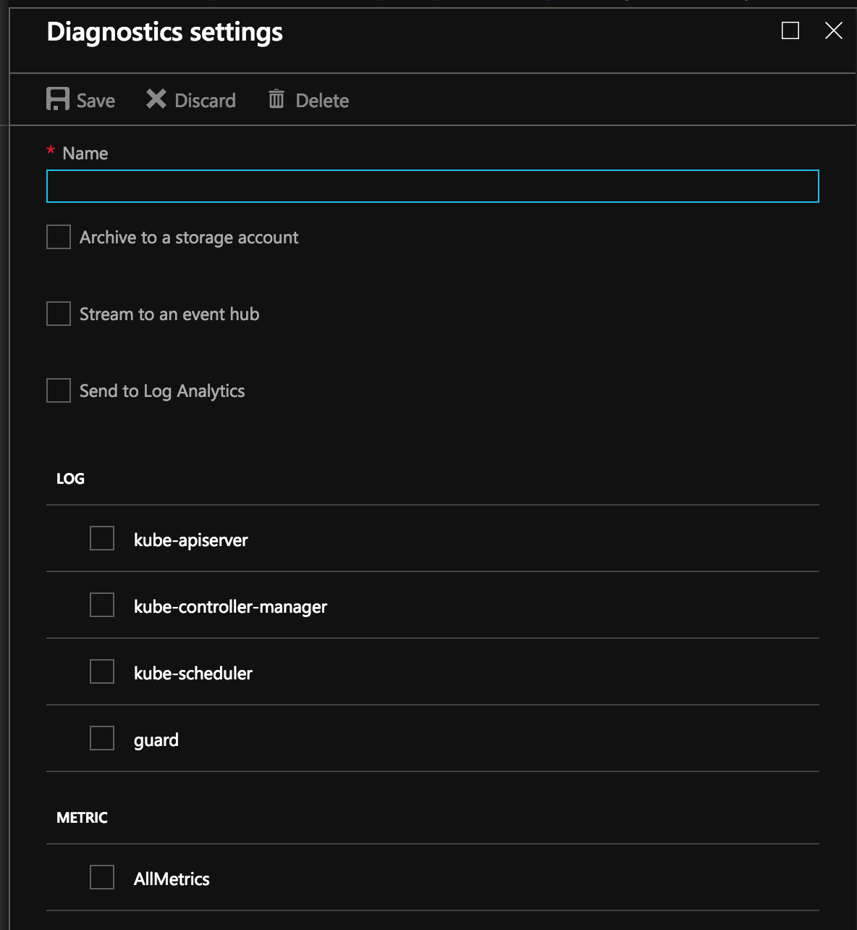
Diagnostic Logs
Use the Azure portal to enable diagnostics logs
Pipe logs to Log Analytics, Event Hub or a storage account
kube-controller-manager
kube-api-server
kube-scheduler
kube-audit logs (direct to Storage Account to reduce costs)

Slide 58
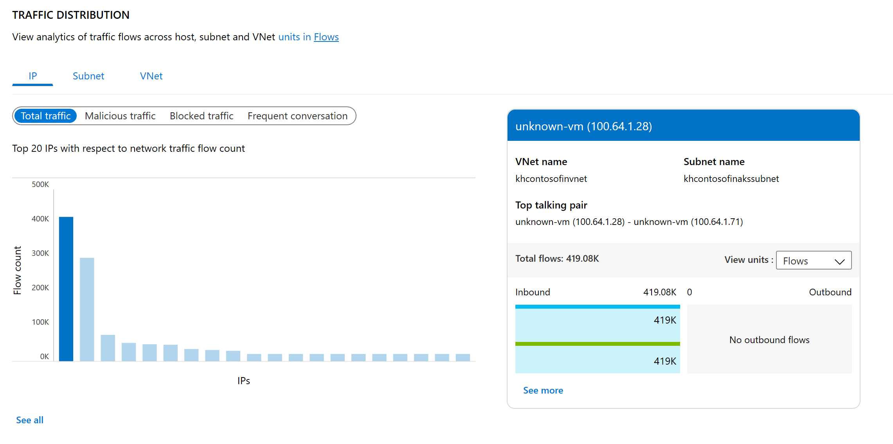
Traffic Analytics
View Ports and VMs Receiving Traffic from Internet
Find Traffic Hot Spots
Visualize Traffic Distribution by Geography
Visualize Traffic Distribution by Virtual Networks
Visualize Trends in NSG Rule Hits
…

Slide 59
What to be careful when monitoring Kubernetes?
Workloads
Health, performance, SLA (create, start, end)
Restart counts
Crash loop
Workload Sizing and Tuning
noisy neighbor
limits/requests per workload – oversubscription
pod anti-affinity – distribution of containers among nodes
Cluster (Orchestrator) “itself”
etcd, kube-api, increasing pending pods can pause any deployment running
capacity – do I need to scale up/down?
Platform – Node, Network, Storage

Slide 60
To-Do
Observability Hands-on Exercises

Slide 61
Discussion
What worked? What didn't work?
Were steps/guidance missing? (ie. Is the content good enough or too much?)
Was there something in there you were expecting to see, but didn’t?
What is the difference between capturing Metrics and Logs?
Why is it important to observe the infrastructure?
Why are we recommending Azure Monitor for Containers and Prometheus + Grafana?

Slide 62
Security

Slide 63
Policy controller
Admin adds policy for the cluster
Admin
User
Admin
Admin audits compliance of the cluster using /audit endpoint
3
Run audit
2
Create + Update
Policy as CRDs
1
User uses standard Kubernetes API to operate the cluster and the create actions are guarded by policy
kubernetes-policy-service
/admit
kubernetes-apiserver
4
Kubernetes-policy-controller provides an admission controller webhook that performs evaluations by calling open-policy-agent (OPA) service
/audit
/admit
watch
kubernetes-policy-controller
kubernetes-mgmt
audit
policy-admit
opa-admit
k8s object watcher
policy-crd-watcher
/query
/data
/policy
open-policy-agent

Slide 64
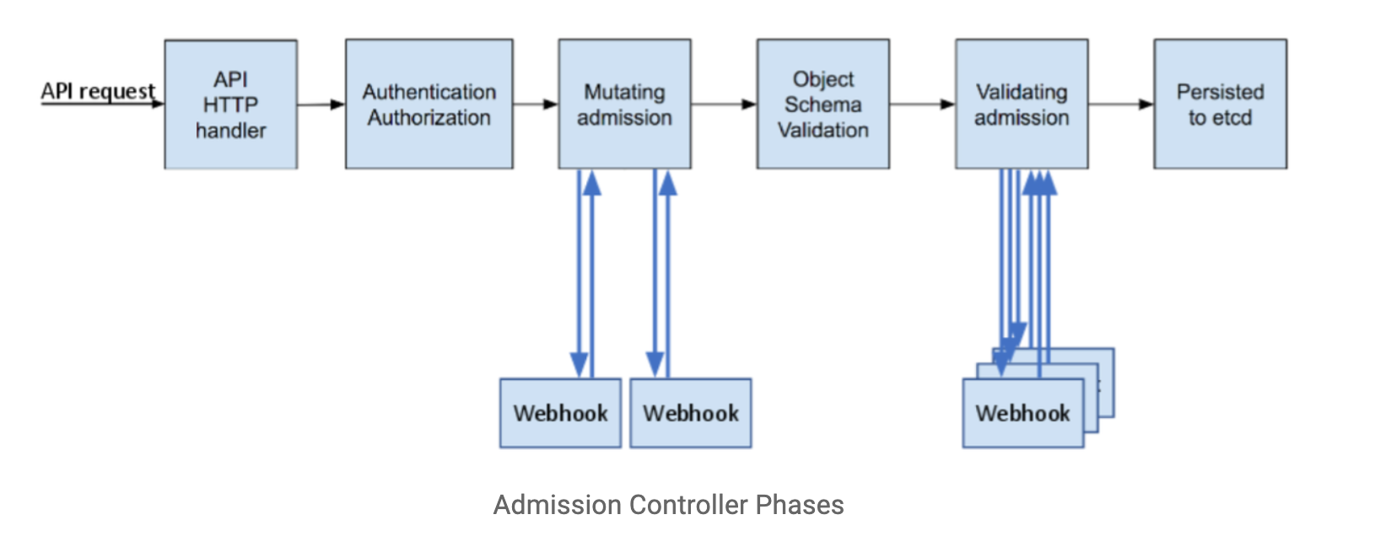

Slide 65
Dynamic Admission Control
Validating Webhook
Allows you to intercept and validate requests
Can be run in parallel, as they don’t mutate objects
Example use case: restricting resource creation
Mutating Webhook
Executes the mutation by sending requests to webhook server
Matching webhooks are called in serial
Example use case: injecting side cars
Policy Enforcement
Admission Control is policy based on Kubernetes objects.
Network Policy and PodSecurity Policy focus on data plane policy
RBAC is policy enforced on the user
Notes:
Talk more of what can Dynamic Admission controllers are and their use cases
; each one may modify the object if it desires

Slide 66

That’s awesome! But…
Notes:
So yes dynamic controllers are awesome, but they create a lot of custom code that has to be mainted and configured in Kubernetes

Slide 67
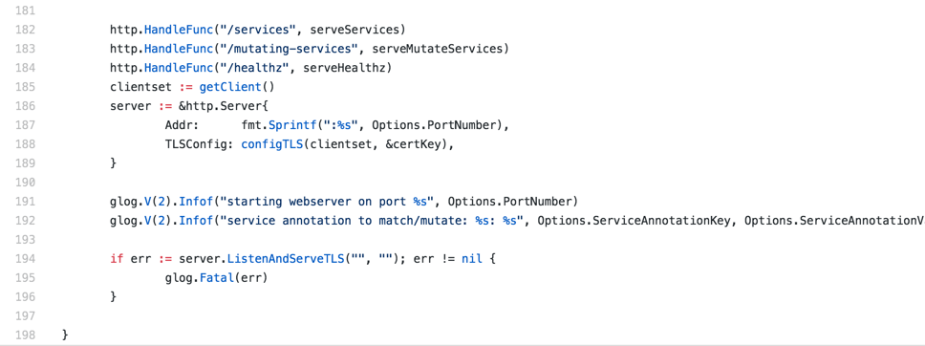
Sample Admission Webhook

Slide 68
Open Policy Agent
CNCF Hosted Sandbox Project
General purpose policy engine
Can be used across the stack
Declarative policy language (Rego)
Image: openpolicyagent.org
Notes:
Overview key features of the Open Policy Agent

Slide 69
Request
Service refers to:
Kubernetes API
Custom API
SSH Daemon
Terraform
Authorization APi
Service
Enforcement
Policy
Query
Policy
Decision
OPA
Input can be any JSON value:
"kind": "Service",
"metadata": {
"annotations": {
department: dev
}
Output can be any JSON value:
”true
”request annotated” “ “annotations": {
costCenter: 8000
}
Policy
(Rego)
Data
(JSON)
Diagram rewritten from: www.openpolicyagent.org
Notes:
More detail in how Open Policy agent makes enforcement decisions

Slide 70
Example Rego Policy
Rego is a policy language and not a programing language, so don’t think about sockets, methods, binary trees, etc.
Think about two things: Logic and Data
Rego logic is all queries. A query finds values for variables that make boolean conditions true.
You write logic to search and combine JSON/YAML data from different sources.
deny[{
"id": "conditional-annotation",
"resource": {"kind": kind, "namespace": namespace, "name": name},
"resolution": {"patches": p, "message" : "conditional annotation"}, }] {
matches[[kind, namespace, name, matched_object]] matched_object.metadata.annotations[”Mr-T"]
p = [{"op": "add", "path": "/metadata/annotations/cost-center", "value": ”A-Team"}] }
Notes:
Outline rego and a sample policy

Slide 71
Who manages all this policy?
Developer
Deploys Apps
Ice Kube
OPA Policy
Audits Platform
Platform Operator
Creates And Maintains
The Governor
Acid Burn

Slide 72
Kubernetes Policy Controller
Kubernetes Policy Controller
Moving to OPA org, as a standard Kubernetes Policy Controller
Authorization module makes it possible to implement a blacklist in front of RBAC
Provides auditing features
Deployment consist of three containers: OPA, kube-mgmt., and Controller
Examples:
Whitelist / blacklist registries.
Not allow conflicting hosts for ingresses.
Label objects based on a user from a department.
Block kubectl exec <pod>
Notes:
General Overview of of the Kubernetes Policy Management Controller

Slide 73
The Good, The Bad, and Gotchas
Good
OPA approach allows you to decouple policy from your applications
General purpose, so can be used outside of Kubernetes context.
Bad
There can be a learning curve to Rego.
Can cause latency, but’s negligible for most apps. (more of a consideration)
Gotchas
Mutating objects need to be handled with care. They can cause unexpected behavior to what the end-user expects.
Notes:
Talk about takeaways and what attendees learned and renforce how OPA\Policy controller solves the Problem from first few slides

Slide 74
Find Public IP Endpoints
AKS api-server – Needed for Authorized IP Ranges
WAF (Azure Application Gateway) – Ingress point for Ingress Controller and Application Workload

Slide 75
Securing Workloads – AAD Pod Identity
Kubernetes operator defines an identity map for K8s service accounts
Developer
<\>
Node Managed Identity (NMI) watches for mapping reaction and syncs to Managed Service Identity (MSI)
Kubernetes
3
MIC Azure Identity Binding
Kubernetes controller
Azure SQL Server
Pod
1
Developer creates a pod with a service account. Pod uses standard Azure SDK to fetch a token bound to MSI
Active Directory Pod Identity
Token
4
Azure MSI
Pod uses access token to consume other Azure services; services validate token
NMI + EMSI
2
Notes:
Pod Identity requires two components:
Managed Identity Controller (MIC). A pod that binds Azure Ids to other pods - creates azureAssignedIdentity CRD.
Node Managed Identity (NMI). Identifies the pod based on the remote address of the incoming request, and then queries k8s (through MIC) for a matching Azure Id. It then make a adal request to get the token for the client id and returns as a response to the request. Implemented as a DaemonSet.

Slide 76
ACR Permissions
No ImagePullSecrets
Leverage AKS Service Principal

Slide 77





Container Level – Images and Runtime
Regularly apply security updates to the container images
Scan your images, scan your containers
Runtime enforcement and remediation
Trusted Registry
Aqua and Twistlock container security
AKS production cluster
Web tier
Azure Container Registry
Helm chart
Source code control
Azure Monitor
Aqua, Twistlock, Neuvector Container Security
Business tier
Auto-build
Azure Pipelines/ DevOps Project
Database tier
CI/CD
Notes:
For runtime enforcement, consider a process that deploys only those images that pass vulnerability scanning and those that adhere to the organization’s hardening policies. Kubernetes provides mechanisms to exercise such enforcement policies.
For remediation, ensure that the vulnerability scanning and security assessment function is integrated with the organization’s continuous integration/continuous deployment (CI/CD) pipeline. This way, the scanning results are fed directly to the pipeline, thereby kicking off remediation workflows before deployment. This should, in turn, be integrated with Kubernetes’ rolling updates feature, ensuring vulnerable containers are taken offline and replaced with freshly built images without the known flaws.

Slide 78
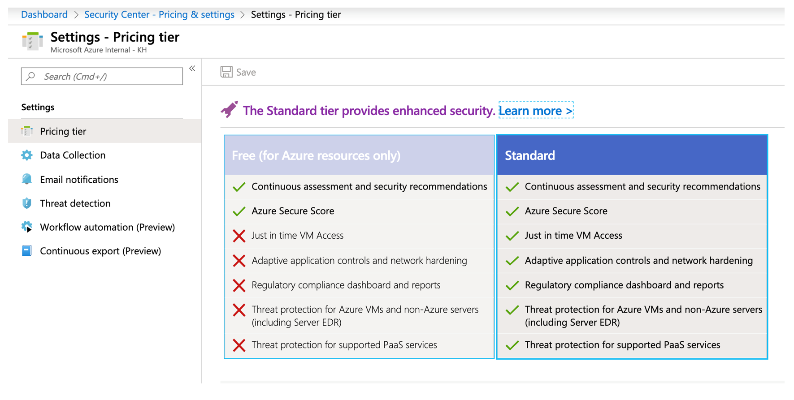
Azure Security Center
Notes:
- All about Cloud Posture

Slide 79
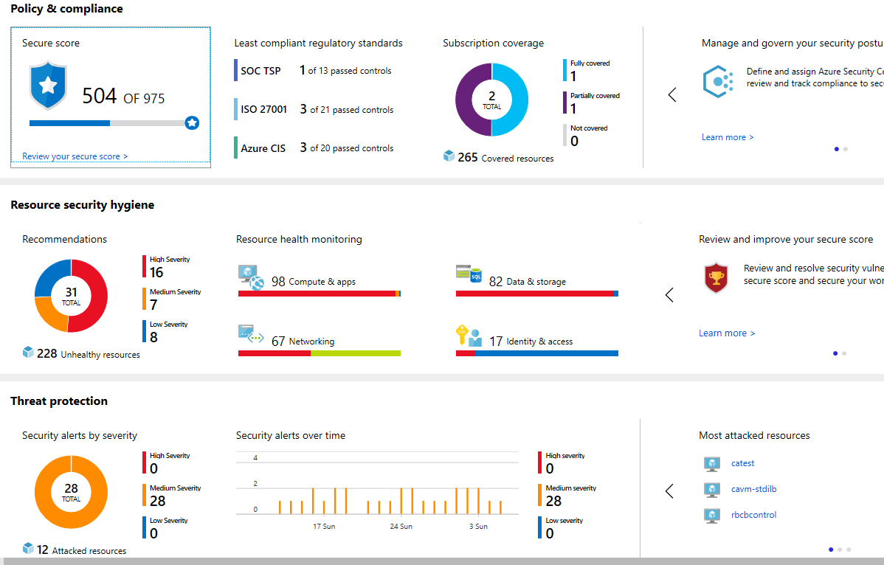
Azure Governance – Compliance
Overall # of Security Controls adhered to across all deployments.
Clear indicator how many Production Subscriptions are BMOcompliant.
Resource Count where security posture is no longer safe for BMO
BMO Resource Count actively attacked with low, medium or high severity.

Slide 80
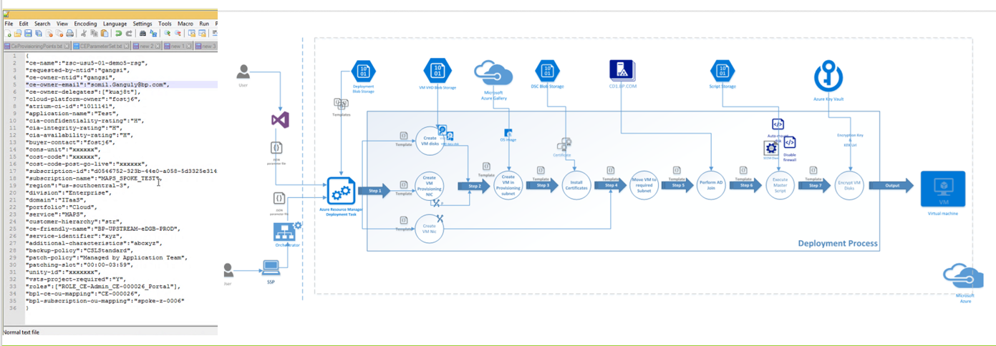
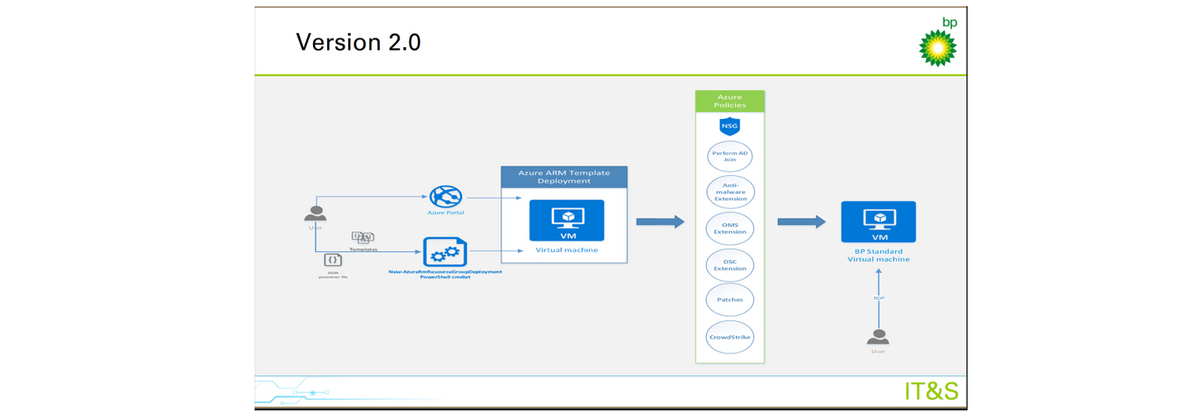
Azure Governance – In Practice
Before
After
Opened Azure Dashboard for use yet assured governed desired state.
Use of Azure Policies

Slide 81
To-Do
Security Hands-on Exercises

Slide 82
Discussion
What worked? What didn't work?
Were steps/guidance missing? (ie. Is the content good enough or too much?)
Was there something in there you were expecting to see, but didn’t?
What are the benefits of leveraging Kubernetes Policy?
What is the advantage of using AAD Pod Identity? Any downsides?

Slide 83
Azure Security Center Integration
Why Azure Security Center?
Container security – security of what?
Offering details
Attack example
What’s next?

Slide 84

Container Security Goals and Objectives
Azure first
Focus on Azure cloud native features
Unique AKS security offering
Leverage inner visibility to AKS nodes, cloud traffic and security controls
Ease of deployment
Out-of-the-box native auto provisioned solution
Single pane of glass for CWP
Part of a cloud security suite and blends in the overall Azure and ASC experience.
AI based features, with cloud-powered intelligence
Leverages Microsoft’s security experience and expertise, and also Azure cloud power

Slide 85



Azure Security Center
Strengthen security posture
Protect against threats
Cloud Security Posture Management
Secure Score | Policies and compliance
For servers
For cloud native workloads
For databases and storage
Get secure faster

Slide 86




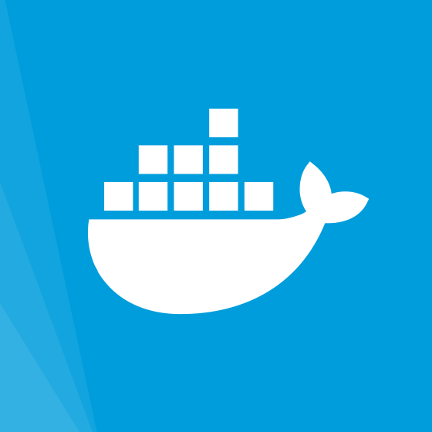


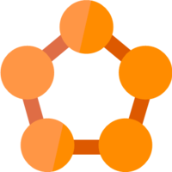
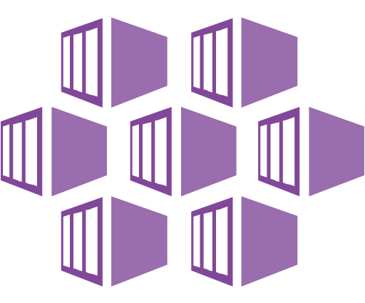
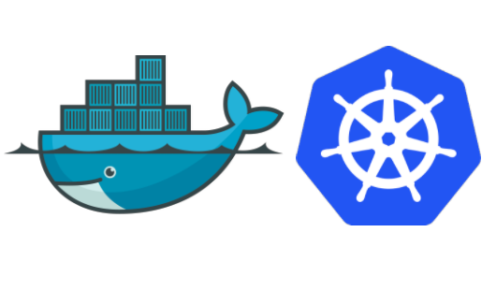


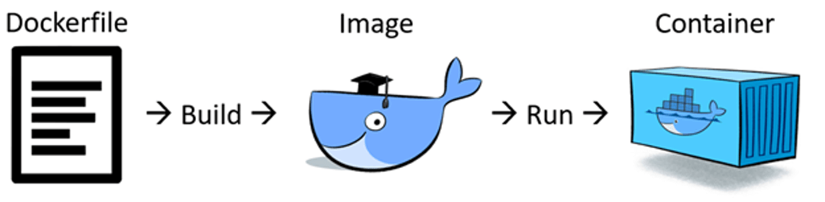
Container Security Lifecycle
Build
Ship
Run
CI/CD
Registry
Platform
Notes:
Container environments bring with them a range of cybersecurity issues involving images, containers, hosts, runtimes, registries, and orchestration platforms, which all need to be secured.
A successful container security program requires integrating security into each phase of the container lifecycle: Build, Deploy, and Run.
Security can’t be an afterthought - It needs to be embedded in the DevOps process,
Organizations need to plan for securing their containerized environment across the entire lifecycle, which includes the build and development process, deployment and run phase of an application

Slide 87



Security Center - Container Security Feature Set
Build
Ship
Run
CI/CD
Registry
Platform
Vulnerability assessment
Environment Hardening
Runtime threat detection
Compliance – CIS Benchmarks

Slide 88
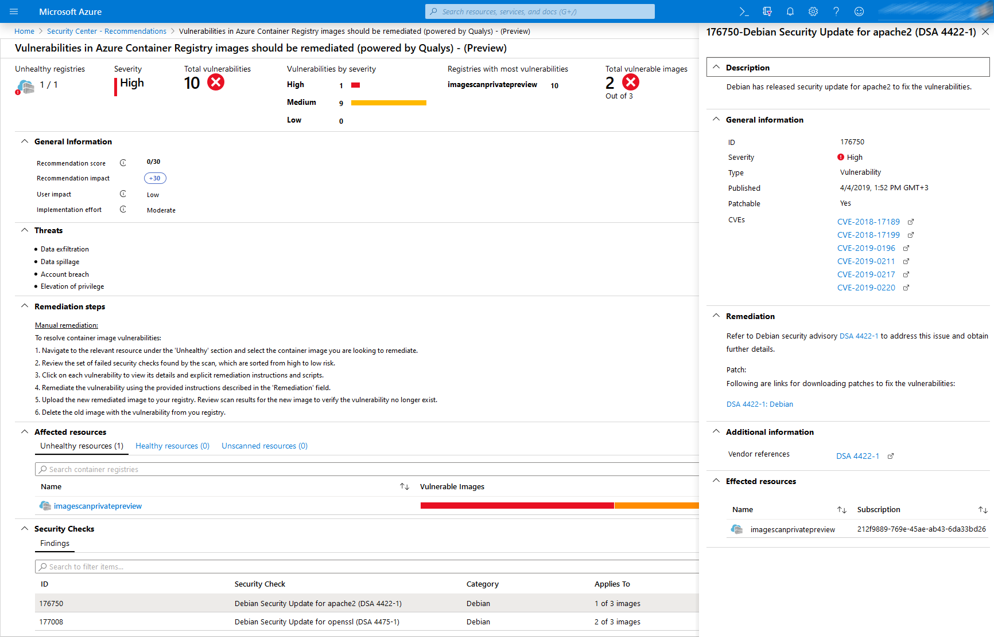
Built-in vulnerability assessment for container images
Public Preview available in standard ASC with a new Container Registries bundle
Seamless deployment and configuration of the vulnerability scanner – Qualys (a VA scanning market leader)
Scan container images for vulnerabilities upon push to an ACR
Visibility to vulnerable ACR container images including vulnerabilities details, severity classification and guidance to remediation

Slide 89
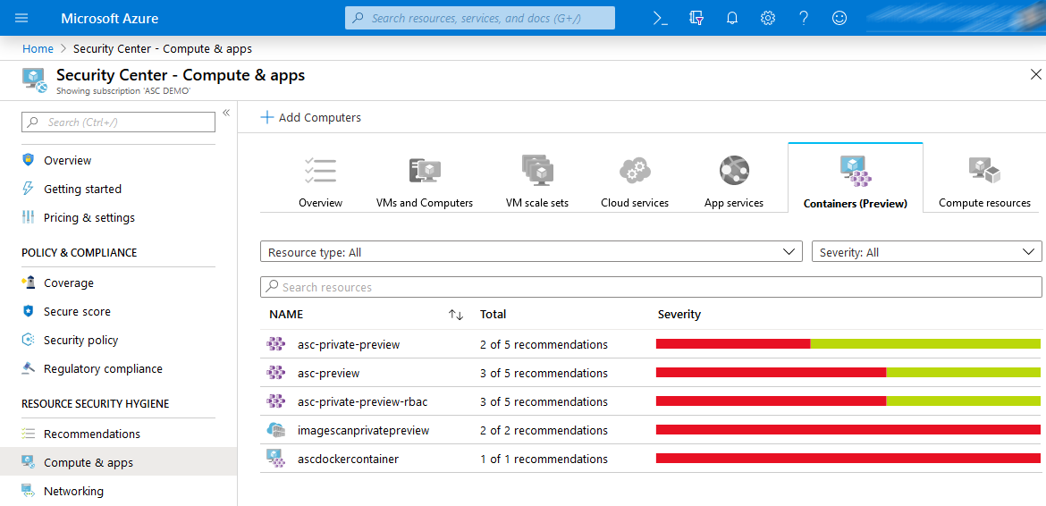
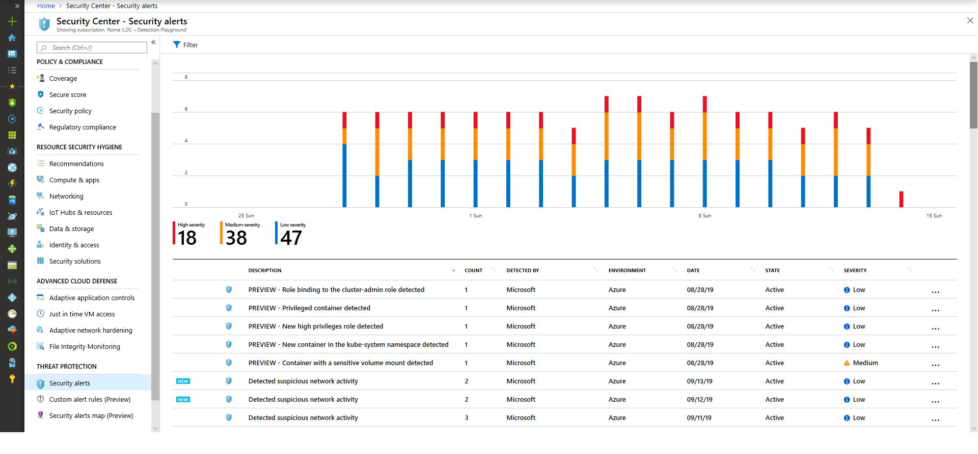
Environment hardening and Threat detection
Available in standard ASC with a new Container Service bundle
Protecting Container hosts (IaaS)
CIS Docker Benchmark assessment continuous monitoring of your Docker configuration against
Node Threat Protection
Intelligent analytics for threat detection
Protecting AKS
Actionable recommendations
based on AKS best practices and includes threat remediation
Cluster and Node Threat detection- Intelligent analytics for threat detection based on AKS audit log and Linux Auditd

Slide 90
Container host level detection- Examples
Standard
Tier
Linux based analytics
Ransomware behavior
Web shell detection
Connection with TI IPs
…
Container based analytics
Privileged container
Exposed docker daemon
SSH server running in a Container
Crypto Mining Container
Suspicious access to API server
- Continues research
- Based on Linux AuditD agent and network information analysis

Slide 91
AKS Cluster Level detection - Examples
New AKS
Bundle
Role binding to cluster-admin
Exposed Kubernetes dashboard
High privileges roles
Create containers in kube-system namespace
Malicious images - digital currency mining container
Privileged containers
Sensitive mounts
Kubernetes audit logs analysis

Slide 92
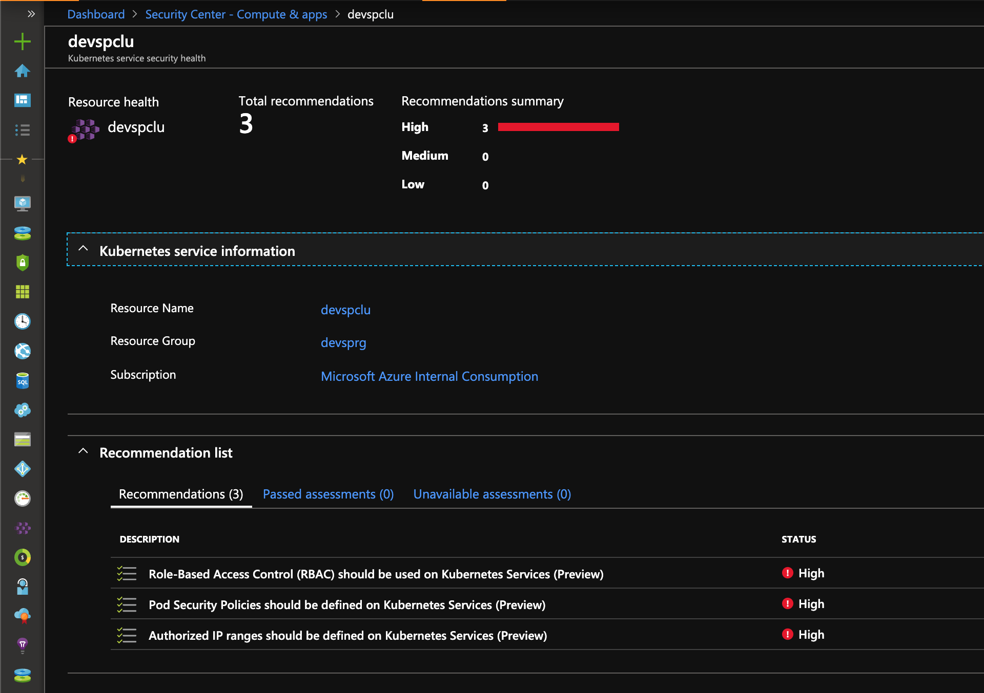
Recommendations based upon security controls enabled in AKS

Slide 93
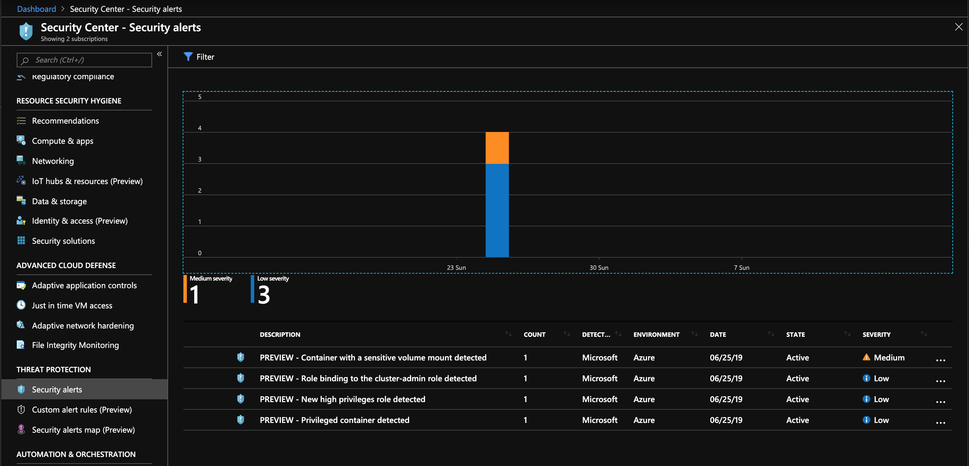
Recommendations based upon audit log analysis

Slide 94
ASC Container Security by Example

Slide 95

ASC protecting against advanced cloud threats
1
Recommending to use RBAC on K8s
Master Node
Recommending fix vulnerable image
API Server
Node 1
Node 2
Node 3
Container
Vulnerable web application
Container
Container
Container
Azure VM
Azure VM
Azure VM

Slide 96

ASC protecting against advanced cloud threats
1
Recommending to use RBAC on K8s
Master Node
Recommending fix vulnerable image
API Server
1
Exploit
2
API request (deploy container)
Node 1
Node 2
Node 3
Container
Vulnerable web application
Container
Container
Container
Azure VM
Azure VM
Azure VM

Slide 97

ASC protecting against advanced cloud threats
1
Recommending to use RBAC on K8s
Master Node
Recommending fix vulnerable image
Detects suspicious request to K8s API
API Server
2
Detects suspicious request to K8s API
1
Exploit
2
API request (deploy container)
Node 1
Node 2
Node 3
Container
Vulnerable web application
Container
Container
Container
Azure VM
Azure VM
Azure VM

Slide 98
ASC protecting against advanced cloud threats
1
Recommending to use RBAC on K8s
Master Node
Recommending fix vulnerable image
Detects suspicious request to K8s API
API Server
2
Detects suspicious request to K8s API
1
Exploit
2
3
Privileged w/ crypto miner & root access to Node 3
API request (deploy container)
Node 1
Node 2
Node 3
Container
Vulnerable web application
Malicious container
Container
Container
Container
Azure VM
Azure VM
Azure VM

Slide 99
ASC protecting against advanced cloud threats
1
Recommending to use RBAC on K8s
Master Node
Recommending fix vulnerable image
Detects suspicious request to K8s API
API Server
2
Detects suspicious request to K8s API
3
Detects privileged container
Detects crypto mining image
Detects sensitive volume mount
1
Exploit
2
3
Privileged w/ crypto miner & root access to Node 3
API request (deploy container)
Node 1
Node 2
Node 3
Container
Vulnerable web application
Malicious container
Container
Container
Container
Azure VM
Azure VM
Azure VM

Slide 100


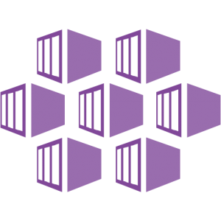
AKS Support in Azure Security Center
1
Continuous discovery of managed AKS instances
Capabilities
Seamless Azure native solution through Security Center
For managed subscriptions, each new AKS cluster and node are discovered in Azure Security Center.
Security Center monitor AKS cluster for security misconfigurations and provides actionable recommendations for compliance with security best practices.
Security Center continuously analyzes AKS for potential threats based on:
Raw security events such as network data and process creation
Kubernetes audit log
and reports any threats and malicious activity detected e.g. “API requests to your cluster from a suspicious IP was detected”
`
2
Actionable recommendations for security best practices
Azure Security Center
3.2
Detect threats across AKS nodes and clusters using advanced analytics
3.1
Azure Kubernetes Service Cluster
Raw
Security
Events
Audit Log
AKS Security Configuration
Verified by Security Center
Master
Workers
Node 1
Node 2
Node 3
API Server
Container Runtime
Container Runtime
Container Runtime
Security Center
Security Center
Security Center

Slide 101
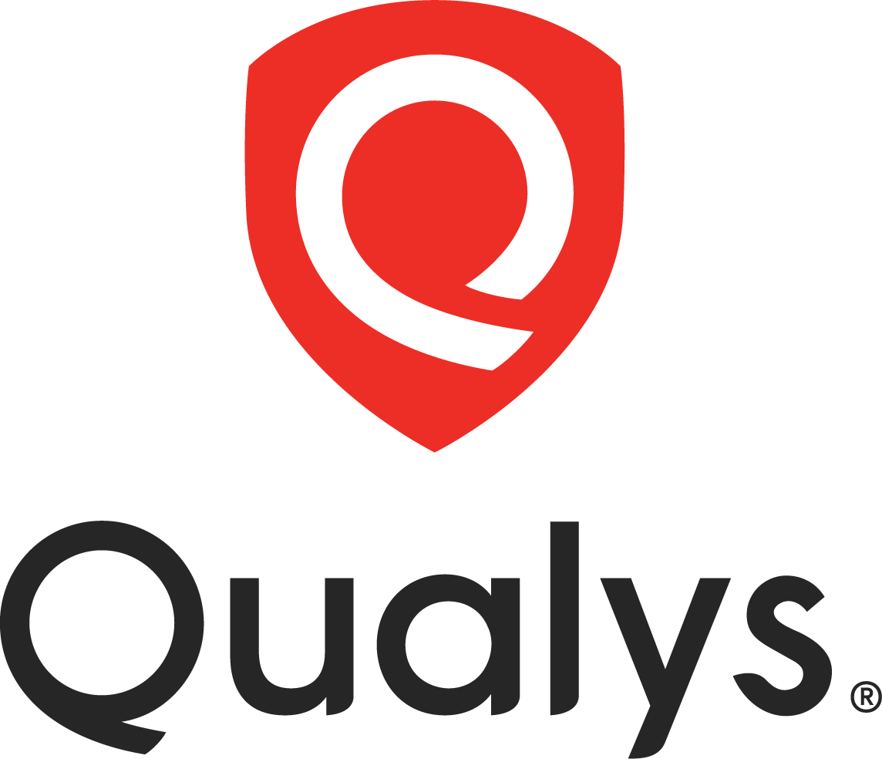
ACR Support in Azure Security Center
Discovery of Vulnerable ACR container images
2
Capabilities
3
Actionable recommendations
Seamless native solution through Security Center
For registered subscriptions, when an image is pushed to an ACR, Security Center scans the image for vulnerabilities utilizing Qualys - a VA scanning market leader
Scanned ACR registries are discovered in Azure Security Center dashboard.
Security Center provides actionable recommendations for images with known vulnerabilities
Security Center provides details for each reported vulnerability along with severity classification and guidance to remediation
Azure Security Center
4
Vulnerabilities details with severity classification
Push container image
CI/CD
Azure Region
Web hook
Azure Container Registry
Azure Container Registry
Azure Container Registry
Azure Security Center
Scanned by Security Center
Vulnerability scanning
1

Slide 102
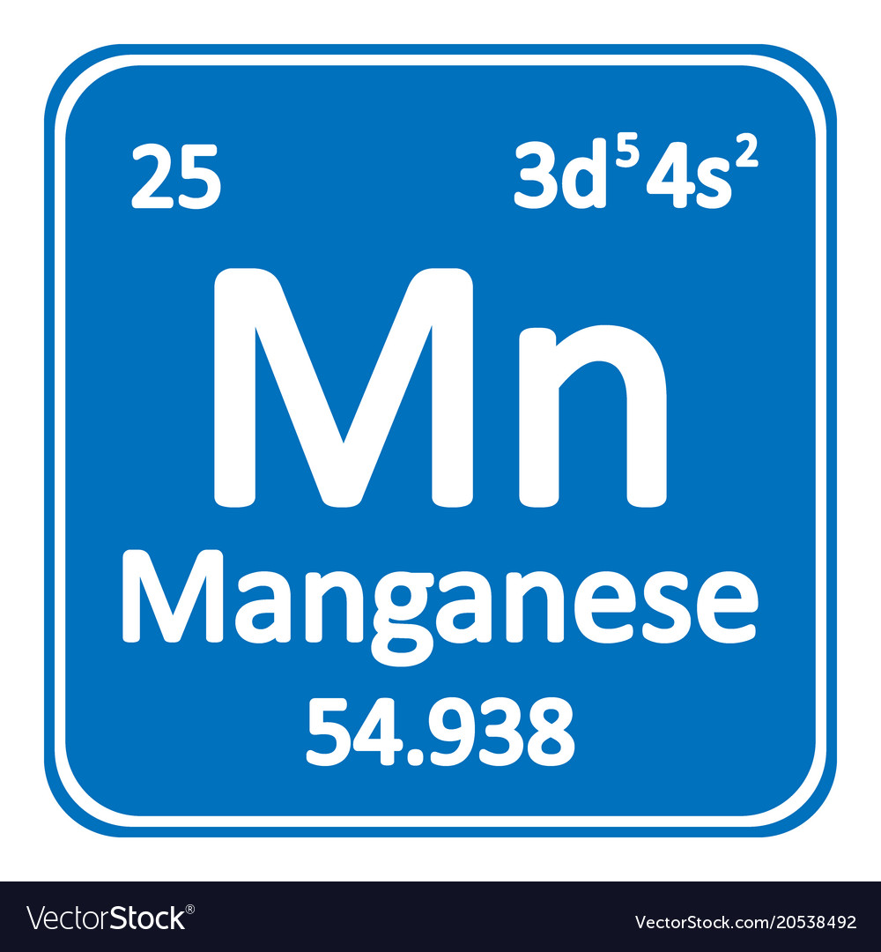
Security Center Container Security - Coming Soon…
Build
Ship
Run
CI/CD
Registry
Platform
Shift left – Image vulnerability assessment
Image vulnerability assessment
Environment Hardening
Code & dependency Scan
Quarantine vulnerable images
Runtime threat detection
Compliance – CIS Benchmarks
This is a directional view of investments, suitable to share with others under NDA. Dates and capabilities are subject to change.
Policy and admission controls
Runtime visibility

Slide 103
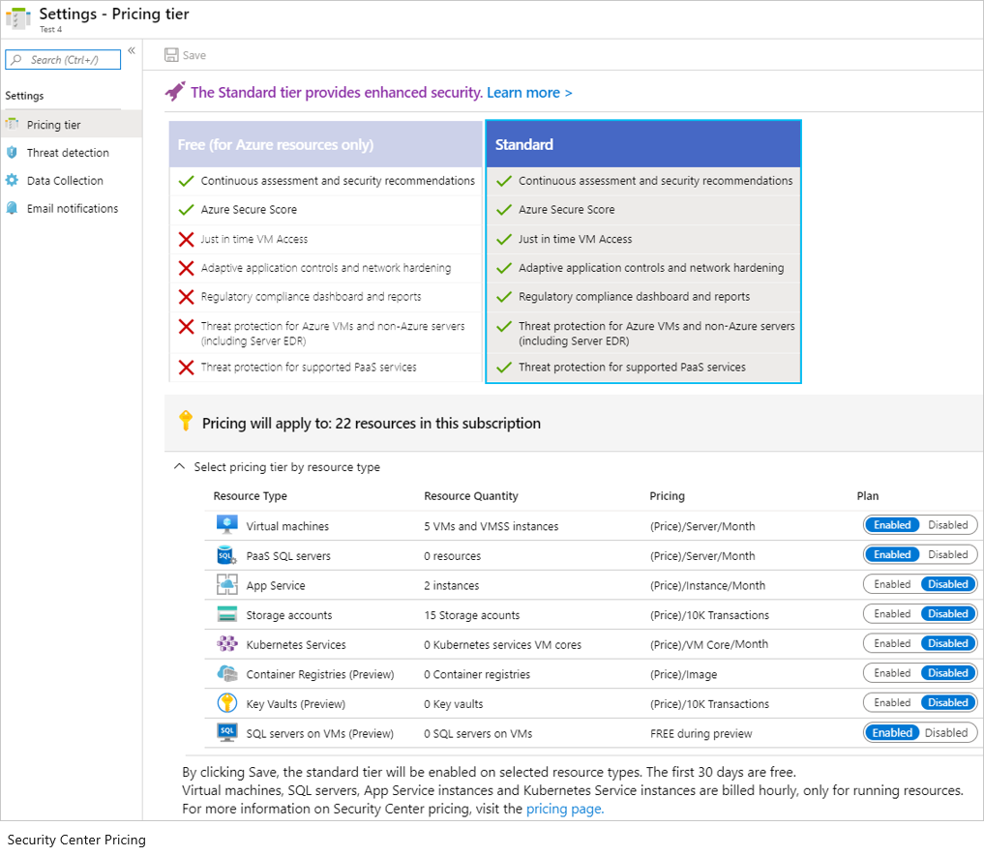
Onboarding

Slide 104
Take Actions
01
02
03
Onboard to the new Security Center bundles: Kubernetes service and Container registry
Prevent attacks by hardening containerized environments and image scan prior to deployment
Detect attacks against containerized environments with ASC Container Security threat detection offering
To learn more, visit https://docs.microsoft.com/en-us/azure/security-center/container-security

Slide 105
Service Mesh

Slide 106
Service Mesh Assumptions
Service Mesh Need is Decided
Service Mesh Capabilities Decided
Service Mesh Technology Decided

Slide 107
Service Mesh
Do I need one?
So “Why?” in the workshop?
Key Capabilities
Encrypt Traffic (Protect Data in Transit)
Canary and Phased Rollouts
Traffic Mgmt & Manipulation
Observability
Why Linkerd?

Slide 108
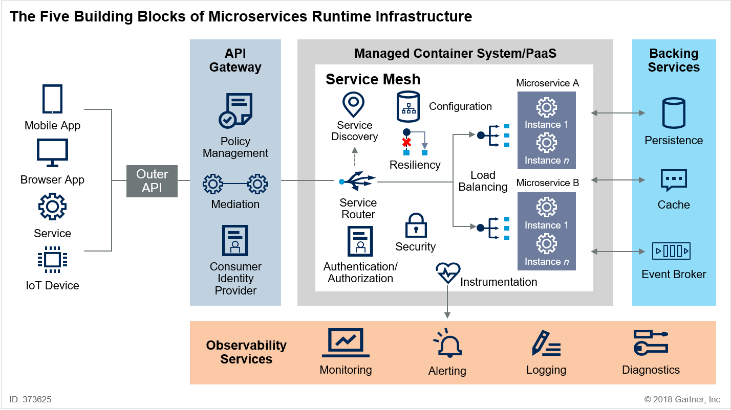
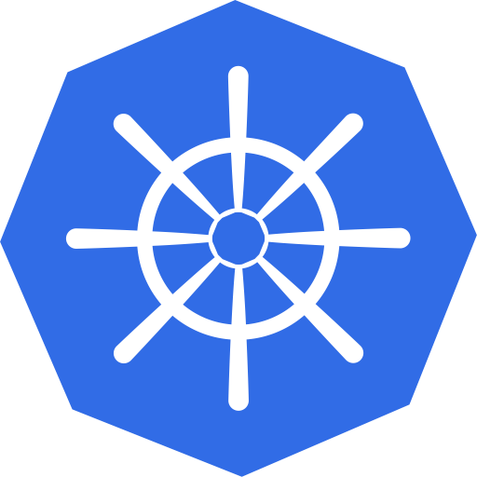
Service mesh overview
KEY OBSERVATIONS
Microservice applications are commonly deployed with containers, which are ephemeral, thus making microservice communications difficult
Service mesh’s primary use case is to manage service-to-service (east to west) communications within managed container clusters
By standardizing traffic management among different services, service mesh is standardizing app runtime operations
Service mesh benefits help with the availability, resiliency, scalability, visibility, etc.
Also enables uniform code changes, polyglot systems, and DevOps practices
Service mesh capabilities
Configuration
Observability
Instrumentation
Load balancing
Routing
Resiliency
AuthN / AuthZ
Encryption
Microservices runtime infrastructure flow
Kubernetes
VMs
Source: Gartner, “Innovation Insight for Microservices Runtime Infrastructure” (Nov 2018)
Newstack, “The History of Service Mesh” (Feb 2018)

Slide 109
Service mesh solves customers’ pain points with microservice architectures
CUSTOMER PAIN POINTS
SERVICE MESH CAPABILITIES
Discovery
Identifying microservices that are being deployed in separate machines and/or not part of the same application
Load balancing, service entry, etc.
Monitoring
Root cause analysis, dependency mapping, etc.
Distributed tracing, service mesh visualization, metrics, logs, etc.
Resiliency
Fault tolerance, request retries, service updates
Circuit breaker, rate management, request timeouts, etc.
Security
Access control, certifications, etc.
Authentication, authorization, policy enforcement, etc.
Notes:
https://avinetworks.com/what-are-microservices-and-containers/

Slide 110
To-Do
Service Mesh Hands-on Exercise

Slide 111
Discussion
What worked? What didn't work?
Were steps/guidance missing? (ie. Is the content good enough or too much?)
Was there something in there you were expecting to see, but didn’t?
What Service Mesh did you pick and why?
Name three things a Service Mesh provides?
What did you notice about the linkerd top command?
Is it possible to look at the live traffic going to your pod?
What would be a good metric to scale on?

Slide 112





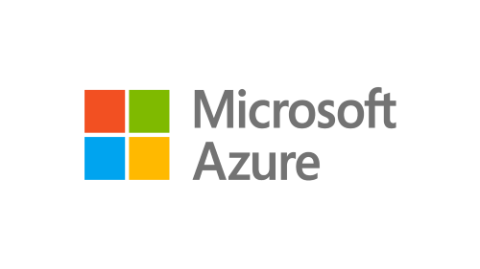
Service Mesh Interface (SMI) for Kubernetes
A Kubernetes interface that provides traffic routing, traffic telemetry, and traffic policy
Standardized
Apps
Tooling
Ecosystem
Standard interface for service mesh on Kubernetes
Simplified
Basic feature set to address most common scenarios
Service Mesh Interface
…and more
Extensible
Support for new features as they become widely available

Slide 113
Wrapping Up & Next Steps

Slide 114
Workshop Goals
Production Patterns for AKS in Azure
How to manage AKS clusters at scale?
What to observe for within AKS clusters?
What security controls should be put in place?
Do I need a Service Mesh?

Slide 115
AKS Setup Before

Slide 116
AKS Setup After

Slide 117
Summary
Use Flux today to help with Cluster Management
Make sure to distinguish between Logging, Metrics and Dashboarding
Leverage Kubernetes Policy Controller for Security Controls
Leverage AAD Pod Identity to reduce Secrets Mgmt
Ensure a runtime image management solution is in place
Make sure to take a step back and determine if a Service Mesh is really needed

Slide 118
Questions
Overall feedback?
What’s missing?
Worthwhile?
What would you like to see next?

